Slide 1

Alternative approaches to teaching key language at KS3/KS4
November 2013
Rachel Hawkes
Notes:
What steps can you take to increase the activity level in your classroom? Approaches to KS3/KS4 and structuring different learning activities for different levels of knowledge.
There is so much that we could look at within this very broad title, but we only have an hour or so, so to chart our way through with a little bit of coherence, I just want us to consider three ideas as a starting point:
1. The standard approaches at KS2 and KS3, and the implications of a potential mismatch in methodology and its impact at transition (if we are not careful).
2. The typical P-P-P model for introducing new language and when / when not appropriate
3. Bloom’s Taxonomy and implications for the way we might want to think about structuring learning sequences.

Slide 2
KS2
KS3
Text
Sentence
Text
Sentence
Word
Word
appreciate stories, songs, poems and rhymes in the language
read literary texts in the language, such as stories, songs, poems and letters, to stimulate ideas, develop creative expression and expand understanding of the language and culture
listen attentively to spoken language and show understanding by joining in and responding
listen to a variety of forms of spoken language to obtain information and respond appropriately
Notes:
The standard approaches at KS2 and KS3, and the implications of a potential mismatch in methodology and its impact at transition (if we are not careful).
This is NOT to say that this is universally the case, either at KS3 or yet at KS2, but if you look at the vast majority of textbooks for beginners at KS3 there is a predominance of word → sentence → text level flow on the page.
Also, just go to the TES and look at 10 PowerPoints – you will most often find the first slides are presentation of individual words (with picture prompts). There might then be some sentence-modelling and at the end a text comprehension.
New language is most often encountered as word first, then sentence, then text.
At KS2 this is often not the case. Often pupils are introduced to new language in a song or a story and this is what starts the learning. Later they pick out words and sentences.
This is not to say that either KS2 or KS3 should change entirely what it is doing, but it gives us significant food for thought about how these two methodologies might best be bridged for smooth transition and equality of experience. The best approach may be some inter-borrowing of one to the other – KS3 from KS2 and KS2 from KS3 (particularly in the upper two years of KS2 perhaps?)
That’s the first thought.

Slide 3
P - P - P
Presentation
Practice
Production
Notes:
The typical P-P-P model for introducing new language and when / when not appropriate
This is a typical model for a teaching sequence, that all teachers will recognise having used. It may be their standard practice, or just something they do sometimes.
There’s nothing to say that it’s not absolutely appropriate either.
But it’s important to consider when it’s most appropriate, and perhaps more importantly, when it might not be so appropriate.
Can people perhaps suggest when it might not be optimal?
1. At the start of KS4, when we know that the vast majority of topics have been met at least once during KS3.
2. At the start of KS3, when we don’t know what experiences of language learning KS2 pupil have had.
3. At the start of KS3, when we know that our KS2 pupils have had varied experiences.
4. At the start of any topic in KS3 when we suspect that learners may have some of the vocabulary they need already.
5. When it was the approach we used the lesson before or the topic before (variety is a good thing!)

Slide 4
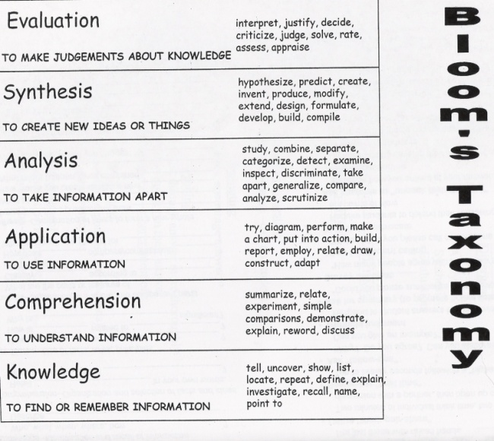

evaluar
crear
analizar
adaptar
comprender
recordar
Notes:
Bloom’s Taxonomy and implications for the way we might want to think about structuring learning sequences.
I’m not a slavish adherent to Bloom’s (or any other model of thinking) taxonomy, but it does us no harm to consider our approach to structuring the presentation of new language / the planning of any learning sequence from this perspective.
If recall and memory are the sole or even predominant focus/objective of any lesson, we might find that the lesson’s main activity base lies at the bottom of this thinking pyramid and that we do relatively little if anything to involve other (higher?!) aspects of thinking.
This is a easy danger for us as memory work is very important in language learning. However, there are ways for learners to practise recall and memory work outside the lesson time too, and this can free up some lesson time for other aspects of language learning. We will come back to this and the other two ideas about learning throughout this session.
So, with these 3 ideas firmly in mind, let’s have a look at a concrete scenario to put things into context.

Slide 5

Escribe unas frases sobre tí.
Mi nombre es Carlos Vicente. Soy de España pero mis padres son de Argentina así que soy argentino. Hablo el español, por supuesto, el inglés y un poco de francés. Vivo ahora con mis padres; vivimos en Valencia, en el este del país. Mi hermana no vive allí. Ella y su amiga viven en Barcelona.
Notes:
This is a slide from Lesson 20 on our current Y7 Scheme of Work. A couple of lessons after this we do an assessment, around November time. It follows a series of lessons during the first half-term in which we:
1) teach (or recap) phonics and apply this in various ways
2) introduce classroom language
3) do some work on memory skills
4) teach pronouns
5) teach some simple sentence-building with ser 3rd pers + cognatives – es / no es
6) teach the alphabet and practise como se escribe…
7) introduce countries
8) introduce the ver ‘SER’ – to be
9) nationalities / languages (including implicit intro to adjective endings)
10) Introduce and use ‘Pienso’ – ‘Pienso que’
11) verb ‘HABLAR’
12) verb ‘VIVIR’

Slide 6
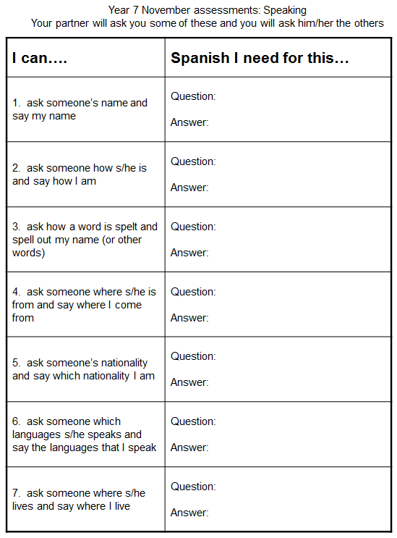
Notes:
This is the speaking assessment. They need to be able to ask and answer the questions.
Problem.
They arrive to us with varying levels of knowledge and experience of Spanish, ranging from nothing to most of what is in this assessment.
What are we going to do about this?
I’ve been giving this some thought. It is NOT to say that I’m going to throw out all of the first 24 lessons in our SoW, BUT I have been thinking about how important it might be approach learning differently.
This involves shifting the balance from a position whereby we sort of assume they are starting from scratch (more or less) and we start instead at text level work to draw out what they know and use that as a starting point for adjusting / planning the learning on the SoW that follows.
Here is a potential teaching sequence that uses the text from lesson 20 but rather than using it at the start of November, we use it instead at the start of September, essentially in Week 1.

Slide 7


¿Cómo se dice … en inglés / español?
1
Pienso que …es…
¿Qué piensas?
¡No lo sé!
¡Sí!
¡No!
Week 1 Year 7
Notes:
Teaching the language of working together – asking for each other’s prior knowledge, but also encouraging hypothesising, risk-taking.

Slide 8

2
Me llamo Carlos Vicente. Soy de España pero mis padres son de Argentina así que soy medio argentino medio español. Hablo español, por supuesto, inglés y un poco de francés. Vivo ahora con mis padres; vivimos en Valencia, en el este del país. Mi hermana no vive allí. Ella y su amiga viven en Barcelona.
Notes:
Year 7 – Week 1. Start with a text and see what students know first.
1. Give them some time to interrogate each other’s knowledge and make some hypotheses about words they might know.
When they have finished talking they could record their group knowledge in a couple of different ways.
They could have a red / yellow / green post-it notes for unknown / think we know / know words
They could shade a large copy of the text with these colours.
Next steps depend on the knowledge of the class, but there are certain key activities that we can be sure will be beneficial for linguistic and skill development. So, for example:
2. Teacher reads the text several times through (3-4 times) at normal speed, but with a few differences. These could be differences in wording where the meaning is the same OR different words which change the meaning of the text, but I think it’s clearer to choose either one or the other and keep consistent throughout the text. So, with this text, I’ve chosen to do different wording where the meaning is the same. As below:
Mi nombre es Carlos Vicente. Soy de España pero mis padres son argentinos así que soy medio argentino medio español. Hablo español, claro, inglés y un poco de francés. Vivo ahora con mi familia; vivimos en Valencia en el este de España. Mi hermana no vive en Valencia. Ella y su amiga tienen un apartamento en Barcelona.
There are 6 x differences. First, students can be asked to underline where the text is different. On subsequent listenings, they can try to identify what the exact differences are and write down the words they hear. This is transcription! It reinforces phonic knowledge that they may have from primary school. If they find this hard, the teacher will know that they need some phonics reinforcement (may need to revise the key sounds with gestures from phonics words).
The teacher can take whole class feedback here and display the words that are different. The class can be asked whether the meaning is the same. Significa lo mismo? Algo diferente? The word ‘sinónimo’ is one they will be familiar with from KS2 literacy – this will make a useful link for them. It lays a bit of a foundation marker for the next 5 x years of language work too, as we will want them to use a variety of different language in their work.

Slide 9
Me llamo Carlos Vicente. Soy de España pero mis padres son de Argentina así que soy medio argentino medio español. Hablo español, por supuesto, inglés y un poco de francés. Vivo ahora con mis padres; vivimos en Valencia, en el este del país. Mi hermana no vive allí. Ella y su amiga viven en Barcelona.
Notes:
1. Teacher reads the text several times through (3-4 times) at normal speed, but with a few differences. These could be differences in wording where the meaning is the same OR different words which change the meaning of the text, but I think it’s clearer to choose either one or the other and keep consistent throughout the text. So, with this text, I’ve chosen to do different wording where the meaning is the same. As below:
Mi nombre es Carlos Vicente. Soy de España pero mis padres son argentinos así que soy argentino. Hablo español, claro, inglés y un poco de francés. Vivo ahora con mi familia; vivimos en Valencia en el este de España. Mi hermana no vive en Valencia. Ella y su amiga tienen un apartamento en Barcelona.
Students can be invited to compare their answers in their groups, or not, depending on time etc.
There are 6 x differences. First, students can be asked to underline where the text is different. On subsequent listenings, they can try to identify what the exact differences are and write down the words they hear. This is transcription! It reinforces phonic knowledge that they may have from primary school. If they find this hard, the teacher will know that they need some phonics reinforcement (may need to revise the key sounds with gestures from phonics words). The task has built-in differentiation.

Slide 10
Mi nombre es
___________ Carlos Vicente. Soy de España pero mis padres son __________ así que soy medio argentino medio español. . Hablo español, __________, inglés y un poco de francés. Vivo ahora con ___________; vivimos en Valencia, en el este __________. Mi hermana no vive allí. Ella y su amiga ________________ en Barcelona.
argentinos
claro
mi familia
de España
tienen un apartamento
Notes:
The teacher can take whole class feedback here and display the words that are different. The class can be asked whether the meaning is the same. Significa lo mismo? Algo diferente? The word ‘sinónimo’ is one they will be familiar with from KS2 literacy – this will make a useful link for them. It lays a bit of a foundation marker for the next 5 x years of language work too, as we will want them to use a variety of different language in their work.

Slide 11
3
Me llamo Carlos Vicente. Soy de España pero mis padres son de Argentina así que soy medio argentino medio español. Hablo español, por supuesto, inglés y un poco de francés. Vivo ahora con mis padres; vivimos en Valencia, en el este del país. Mi hermana no vive allí. Ella y su amiga viven en Barcelona.
vivir | to live
vivo | I live
 | she lives
 | we live
 | they live
 | I call myself
me llamo
hablo
 | I speak
vive
vivimos
soy
 | I am
viven
son
 | they are
Notes:
3. After the listening / transcription tasks, there are some next steps that focus further on meaning and/or structure. The teacher may need to choose here, rather than do everything with one text in one lesson!
With this text there are 3 x obvious possibilities:
1. Focus on verb forms.
2. Focus on country / nationality / place vocabulary
3. Focus on the meaning of high frequency language – de – pero – y – con – en – así que – por supuesto – allí - su
I would be most tempted to start with the verb forms, to tease out prior knowledge but also work on inference skills.

Slide 12
4
Me llamo Carlos Vicente. Soy de España pero mis padres son de Argentina así que soy medio argentino medio español. Hablo español, por supuesto, inglés y un poco de francés. Vivo ahora con mis padres; vivimos en Valencia, en el este del país. Mi hermana no vive allí. Ella y su amiga viven en Barcelona.
País
Nacionalidad / Idioma
Ciudad
Notes:
4 Focus on country / nationality + language / place vocabulary
I would expect that before doing this activity, the teacher will need to explain the categories.
The idea would be to try to do this in the TL – this provides additional linguistic input through listening, and has the advantage of dealing with one of the words most pupils are unlikely to know – i.e. país
It highlights the all important category words, too, which often get overlooked.
Many pupils can name lots of individual countries but don’t know the word for country itself. Try this out on your classes…
How to circumlocute these words?
1. País – por ejemplo, España es un país. Inglaterra es un país. Italia es un país. Birmingham no es un país. País?...
2. Nacionalidad / Idioma
Soy inglés. Es mi nacionalidad.
Hablo (showing hand gesture for talk, as necessary) inglés. Es mi idioma nativo.
3. Ciudad
Birmingham no es un país. Birmingham es una ciudad. Liverpool es una ciudad. Cambridge es una ciudad. Londres es una ciudad. Madrid es una ciudad….
Then give students a few moments to identify the words from the text in each category and take whole class feedback.

Slide 13
Me llamo Carlos Vicente. Soy de España pero mis padres son de Argentina así que soy medio argentino medio español. Hablo español, por supuesto, inglés y un poco de francés. Vivo ahora con mis padres; vivimos en Valencia, en el este del país. Mi hermana no vive allí. Ella y su amiga viven en Barcelona.
País
Nacionalidad / Idioma
Ciudad
España
argentino
español
Valencia
Argentina
inglés
francés
Barcelona
Notes:
2.2
2
It’s also always useful to see what other knowledge they bring to the table, so an additional oral prompt to name any other countries in Spanish and / or languages and/or cities in Spain is a really good way to extend / differentiate and get to know the prior knowledge of learners. Opening out each task to prior knowledge is a useful principle to keep in mind at each stage of lesson planning.
When taking whole class feedback it would be a lovely opportunity (if you have not already done this with the new Y7 class to ask them to tell you other languages that they speak or if their parents are different nationalities. That’s one reason for choosing a text where the character has parents from a different country). This can be done using the text for reference.
Ok, todos. Escuchad. Carlos es de España. Vive en España, no es así? Pero sus padres son de Argentina, verdad?
Y vosotros? Vuestros padres son de Inglaterra or de otro país? De Holanda? De un país en Africa? O Italia?
If they volunteer some different countries, collect them on a list on the board. Ask about languages? En casa (gesture for house if necessary), habláis inglés? No? Qué idioma habláis?

Slide 14
5
Me llamo Carlos Vicente. Soy de España pero mis padres son de Argentina así que soy medio argentino medio español. Hablo español, por supuesto, inglés y un poco de francés. Vivo ahora con mis padres; vivimos en Valencia, en el este del país. Mi hermana no vive allí. Ella y su amiga viven en Barcelona.
Notes:
5 Focus on the meaning of high frequency language – de – pero – y – con – en – así que – por supuesto – allí - su
It is really up to the teacher (and to time) how many high frequency words to focus on in one lesson.
At the start of the year with year 7 we will not know which words they know.
One thing is sure, though, high frequency words can and should be a priority as they will be needed in every lesson, for understanding but also for sentence-building.
It doesn’t matter if there are some students in the class for whom these are all new. They have by now had so much exposure to the text that the overall content meaning of most of it will be familiar. They will in many cases now be able to infer the meaning of these high-frequency words.
Inference from the other words in the sentence, leading to a conclusion as to ‘what makes sense here?’ and ‘what sounds right?’ is a linguistic skill that we want to promote from day 1.
Give students some time in their group – get them to use the group talk routine again to discuss meanings.
Then take feedback. Draw out the dual meaning of ‘de’ in particular. Do all this orally, without writing up the English on the board.
There may be some that you have to ‘model’ with the correct intonation (e.g. por supuesto / ahora / allí ) or help to define but pupils will get there.
At the end of this task, perhaps get students to add these words to the back of their exercise books in a ‘high – frequency words’ list.
It might not be a dreadful idea, at the conclusion of these 3 x text-focused tasks to ask each group to translate one sentence each from the text into English!
This is just an indication of how I might include transcription and translation into one teaching sequence, rather than ever having one whole lesson on either.

Slide 15


6
Me llamo Carlos Vicente. Soy de España pero mis padres son de Argentina así que soy medio argentino medio español. Hablo español, por supuesto, inglés y un poco de francés. Vivo ahora con mis padres; vivimos en Valencia, en el este del país. Mi hermana no vive allí. Ella y su amiga viven en Barcelona.
¿Qué idiomas hablas?
¿Cómo te llamas?
¿Dónde vives?
¿De dónde eres?
¿Cuál es tu nacionalidad?
Notes:
6 Reading into speaking → hotseating task
We can guess that most students will know the question como te llamas. It may be (perhaps is most likely) that they will not know the others, except perhaps ‘donde vives’.
In this lesson, the focus is mainly on them answering, but clearly we will need soon to do a lot of work on asking questions. At this point the skills we are focusing on are:
1. Understanding the questions
2. Using the text as support to extract answers to questions – it is useful to highlight here that we can answer without using whole sentences – differentiate for learners to make it clear that your main goal here is that they understand the questions and can respond quickly in some way.
Give them the choice of just a name, a single word etc.. OR the whole sentence. Tell them that in real conversational talk, people often just respond with single words. The key in spontaneous talk is to be able to join in and respond immediately and for that, you have to understand the question.
Model this to show what you mean.
3. Get them to practise in pairs. (They will need to read the questions in this lesson as we have not learnt how to ask the questions yet). Check that they can pronounce any new key words – e.g. cual and que and donde.
Using the text as support to structure whole sentence answers to questions – model this too.
Make clear that whole sentences are always appropriate in writing (and only sometimes in speaking). Get them to answer your asking of the questions in whole sentences, using the text as support.

Slide 16
7
Me llamo Carlos Vicente. Soy de España pero mis padres son de Argentina así que soy medio argentino medio español. Hablo español, por supuesto, inglés y un poco de francés. Vivo ahora con mis padres; vivimos en Valencia, en el este del país. Mi hermana no vive allí. Ella y su amiga viven en Barcelona.
¿Qué idiomas hablas?
¿Cómo te llamas?
¿Dónde vives?
¿De dónde eres?
¿Cuál es tu nacionalidad?
Notes:
7 Reading → Speaking → Writing
1 Take the text away. Ask them to pretend to be Carlos. Get them to answer by tracing the words with a finger on the table. Ask ‘Cómo te llamas?’ Bring the text back to see if they spelt Me llamo Carlos correctly. Do the same with the other questions.
4.2 Ask them to be themselves now. Give them mini whiteboards (or exercise books if you prefer) Ask ‘Cómo te llamas?’ and ask them to write a full sentence answer. This time, do not bring the text back each time between questions.
Do the same for all questions.
NB: Tell them that they can ask you for words they need e.g. Inglaterra that have not come up in the lesson so far.
They know how to ask “Como se dice…?” If you haven’t talk “Como se escribe?” yet this is the time to do it – i.e. when they need it.
Make is very very clear that you know they are writing from memory and that there will be some mistakes and this is fine!
Tell them how important writing from memory is and that copying will not teach them as much.
They will end up having written a short paragraph about themselves in Spanish. Level 3 / 4 on NC.
Ask them to add any sentences they want to at the end of the text and to give their work in to you.
Use what you find in their books to inform your next teaching sequence!
One of the things you probably won’t find is extensive use of the high-frequency words OR different verb forms apart from the first person.
So this sets up some learning objectives for the first term immediately.

Slide 17
Summary of learning
Task | Learning objective
1 Group speaking - ¿Cómo se dice? | Retrieve prior knowledge and share it Identify gaps in current knowledge Use TL for routine communication Ask / answer questions in TL
2 Listening | Develop attention to detail in listening Consolidate the sound-writing relationship through transcription Begin to acquire some new vocabulary
3 Reading (in detail) → literacy | Knowledge about verb forms Identify patterns in verb formation Infer meaning of unknown words Acquire high-frequency words Acquire new content/topic vocabulary Show understanding by translating short text into English
4 Speaking – question & answer | Improve speed of understanding spoken language Develop ability to respond spontaneously Recognise the difference in language use (spoken / written register)
5 Writing – question & answer | Write in sentences / short paragraph from memory

Slide 18

Alternative approaches
Starting with a written / spoken text
Flipped classroom
Translation
Categorisation
Harvesting / transfer from a previous topic
Questions

Slide 19


flipped
classroom
http://quizlet.com/30143628/vacaciones-infinitivos-flash-cards/

Slide 20
Last summer…
El verano pasado…
I visited Spain. | Visité España.
First, I swam in the sea.
Then I listened to music on the beach.
One day, I went for a cycle ride.
I sunbathed everyday.
In the evening, I danced in the disco.
I played with new friends.
I took lots of photos.
I relaxed.
de vacaciones on holiday

Slide 21

Alternative approaches
Starting with a written / spoken text
Flipped classroom
Translation
Categorisation
Harvesting / transfer from a previous topic
Questions

Slide 22

Before I used to live in Hardwick but now I live in Cambourne.
Antes vivía en Hardwick pero ahora vivo en Cambourne.
http://www.tagxedo.com/

Slide 23

The good thing is that I have lots of friends there.
Lo bueno es que tengo muchos amigos allí.
Notes:
www.tagxedo.com

Slide 24
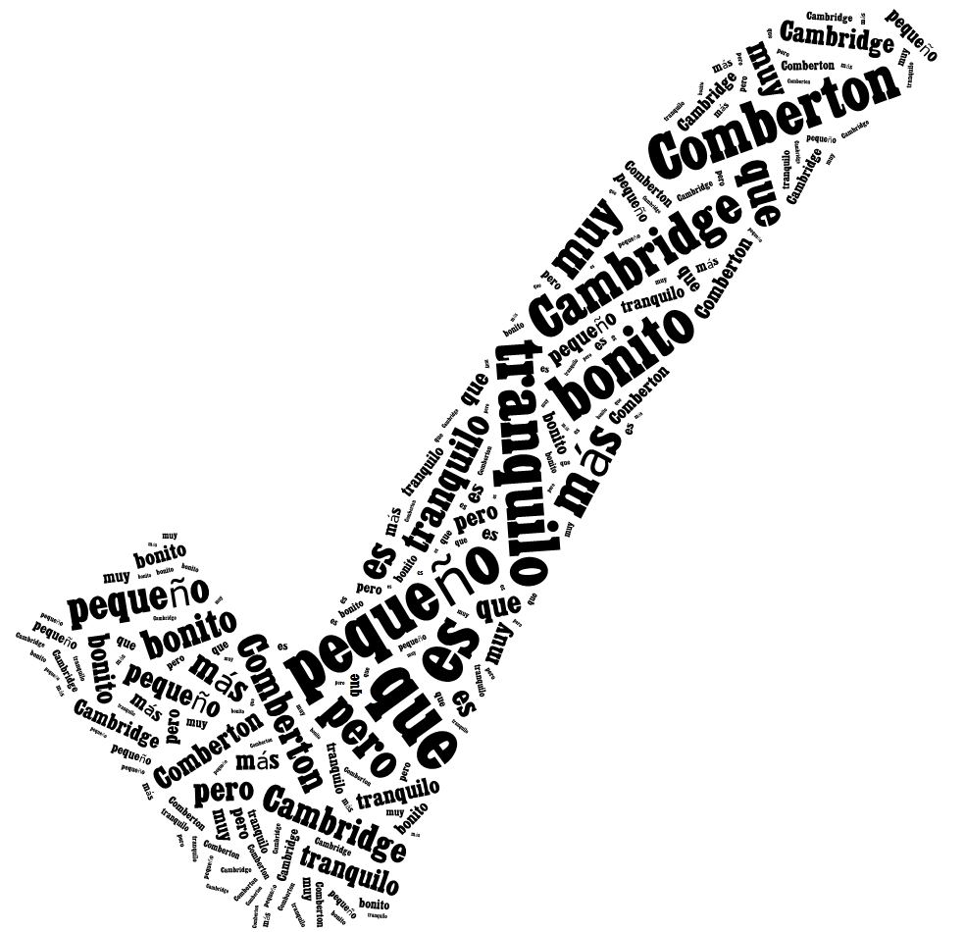
Comberton is smaller than Cambridge but it is quiet and very pretty.
Comberton es más pequeño que Cambridge pero es tranquilo y muy bonito.

Slide 25
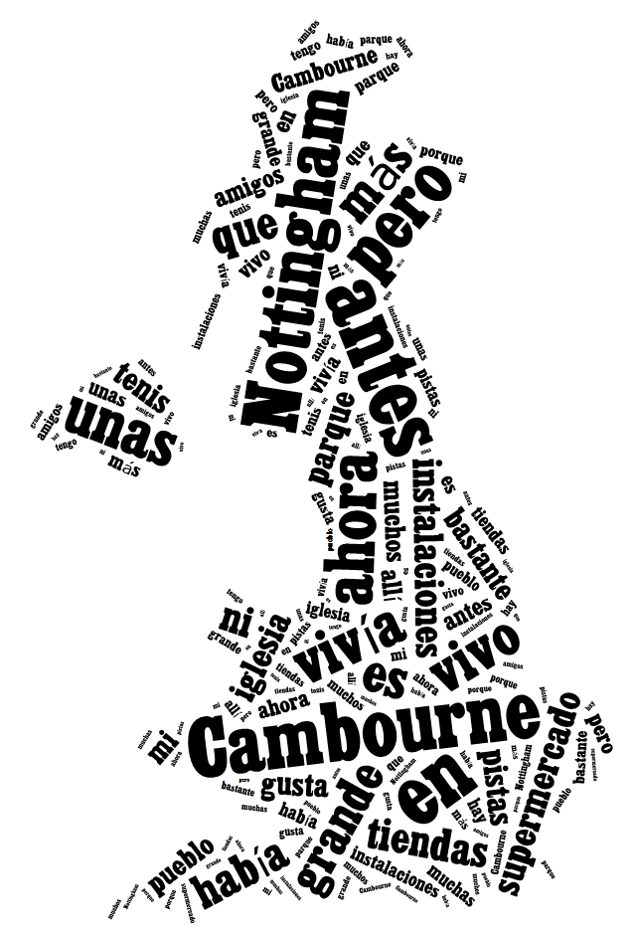
Before I used to live in Nottingham but now I live in Cambourne. Nottingham is bigger than Cambourne. Before in Cambourne there were not many shops nor facilities but now there is a supermarket, a church, a park and some tennis courts. I like my town quite a lot because I have lots of friends there.

Slide 26
Parallel translation - adapted
1 ___ ___ gusta viajar en avión porque _________ me hace vomitar y además es _________ ____________.
1 I don’t _______ _________ ___ ______ _______ sometimes it makes me sick and what’s more it’s very uncomfortable.
2 _________ ___ ______ __________viajar en autocar, ____ _____ _______ e incómodo, así que _________ el tren.
2 Although it’s cheaper ______ ____ _______, it is very boring _______ and uncomfortable, _____ I prefer the train.
3 Para mí lo ______es el ________ porque es _____ rápido y es __________emocionante.
3 _____ _____ ____ best is the plane because it’s very ______ and quite ____________.

Slide 27

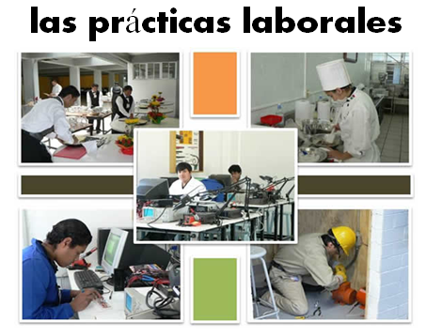
Bridging the gap - adapted
When?
Where?
How long?
What did you do?
¿Qué experiencia tienes del mundo laboral?
¿Dónde hiciste tus prácticas?
¿Cuánto tiempo duraron las prácticas?
¿Cómo ibas a tu lugar de trabajo?
¿Te gustaron las prácticas?
How get there?
Start / finish?
Good / bad?
People?
Notes:
Writing about work experience (whilst it’s still fresh in their minds!)
Explain the task:
Stage 1: Brainstorm in Spanish anything from your head that you could use to write a short piece of 100 words about your work experience (5-10 minutes) Teacher to correct the TL whilst students to stage 2.
Stage 2: Write in English a piece of 100 words about your work experience. Bear in mind that the end goal is to write a similar piece in Spanish so try to have that in mind i.e. don’t make the sentences too long or complicated (15 minutes)
Stage 3: Get some feedback from your teacher on what you have produced. S/he will help you ‘notice the gap’ between what you have produced in English and your current level of knowledge in Spanish. S/he will help you to focus on some strategies to bridge the gap. See next slide.

Slide 28
Simplifying ideas to fit own repertoire
Re-combining set phrases
Writing / Composition strategies
Avoiding
(say something different)
Re-structuring set phrases
Generating via translation
word for word
Notes:
Remind students what the strategies were and point out how well they used them – give specific examples
1) restructuring set phrase – Phoebe used ‘me hacían reír’ – they made me laugh, which was from media unit – me hacen reír from films
2) avoidance – instead of ‘I got lifts every day’ Ellis used ‘ Iba en coche todos los días’.
3) using set phrases – Lo pasé bomba used by lots of people
4) simplifying ideas – I was welcomed by the people → la gente era muy simpática
5) translation word for word – Ben I assisted in evaluating and developing software – era asistente de pruebas de desarrollo de software
Bridging the gap strategies – display this while students are writing first TL draft.
Use what you have in front of you – i.e. corrected TL brainstorm + English draft + Work Experience booklet + dictionary to write your first draft of 100 words in TL.
Teacher to correct this overnight for Tuesday morning. On fresh piece of A4 lined paper.

Slide 29
Alternative approaches
Starting with a written / spoken text
Flipped classroom
Translation
Categorisation
Harvesting / transfer from a previous topic
Questions

Slide 30
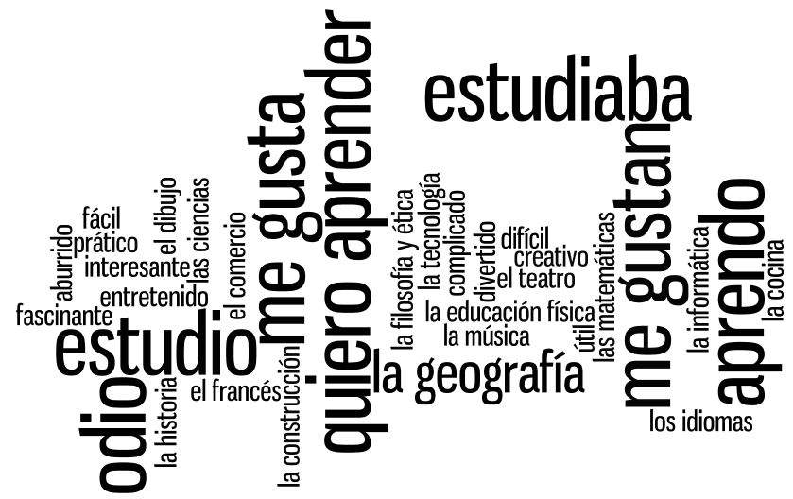

Slide 31
Verbos
(7)
Asignaturas
(16)
Opiniones
(11)
Notes:
Using the wordle, students categorise the words into the 3 sections. Doing this they may need to ask the meaning of certain words. Teacher can explain these in TL – using opposites and examples. Lots of this language should be familiar from KS3. Modelling the difference between estudiaba and estudio can also happen during this activity.

Slide 32
Me gusta porque el profesor me hace reír.
Es (son) mi asignatura favorita.
Lo (la/los/las) estudiaba antes pero ahora no.
Me gusta mucho porque es (son) muy práctico/a(os/as)
Me gusta porque es (son) interesantes.
Me gusta porque es(son) útil(es) e importante(s) para mi futuro.
Nunca lo (la/los/las) he estudiado.
Me gusta porque es fácil sacar buenas notas.
No me gusta porque el profesor es estricto y me da miedo.
No me gusta porque el profesor me da muchos deberes.
No me gusta porque es (son) difícil(es).
No me gusta porque soy flojo(a) en esta asignatura.
Notes:
Students choose a subject that fits this opinion for them personally. They may need to put more than one subject in several boxes and have nothing for another – this is fine!

Slide 33
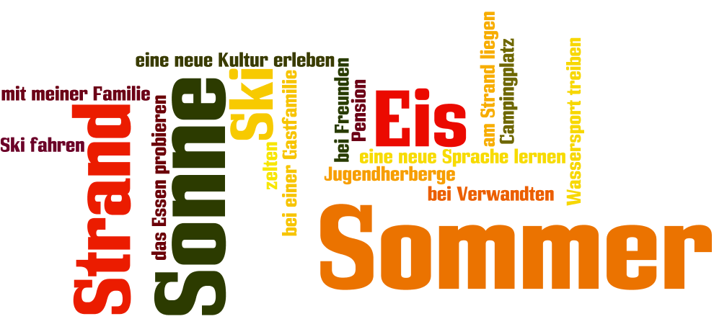
www.wordle.net

Slide 34
Alternative approaches
Starting with a written / spoken text
Flipped classroom
Translation
Categorisation
Harvesting / transfer from a previous topic
Questions

Slide 35
Opiniones y preferencias
El año pasado…/hace 2 años
Mis vacaciones ideales son..
(no)ne gusta(n)
fui(mos)
Lo que más me gusta
viajamos
Lo mejor/lo peor
hicimos
Suelo preferir….
Siempre me ha interesado…
iba
Voy a…
era
Todavía no sé qué quiero hacer..
tenía
A lo mejor, iré a …
había
Cuando sea mayor, me gustaría
En el futuro………..
Cuando era más joven…

Slide 36

Opiniones y preferencias
El año pasado…/hace 2 años
Mis vacaciones ideales son..
(no)ne gusta(n)
fui(mos)
Lo que más me gusta
viajamos
Lo mejor/lo peor
hicimos
Suelo preferir….
Siempre me ha interesado…
iba
Voy a…
era
Todavía no sé qué quiero hacer..
tenía
A lo mejor, iré a …
había
Cuando sea mayor, me gustaría
En el futuro………..
Cuando era más joven…

Slide 37
Mes préférences
Mes vacances dernières
Je m’intéresse à …
Ce que m’intéresse le plus c’est..
Mes vacances idéales sont…
Ma destination préférée, c’est…
A mon avis
Je pense que
Je trouve que
Je suis allé(e) à ….
pour…semaines
Après être arrivé
Avant de partir
J’ai joué au golf
Je joue au golf depuis 3 ans Après avoir (fini)
Je me suis bien amusée
Je viens de lire ta lettre…..
J’allais à….
avec ma famille
Quand il faisait beau je sortais…
Quand il faisait mauvais je restais…
j’aimais beaucoup….
A l’avenir
J’ai envie de…
J’ai l’intention de..
Je voudrais..
J’amerais…
J’irais…..
Si j’avais le choix, j’irais…
mais = but
parce que = because
aussi = also/as well
par exemple = for example
pendant = during/whilst
peut-etre = perhaps
qui = who
si = if
quand = when
et = and
probablement = probably
seulement = only
Quand j’étais plus jeune..
L’année prochaine………..
Notes:
Re-do this mind map with the theme of school and world of work in mind. How could you re-use the language in the new context?
This can be simplified or extended, depending on the level of your students and the grades they are targeting.

Slide 38
Functions |  | Themes
A | Questions | 1 | Future plans
B | Opinions | 2 | Work experience
C | Suggestions | 3 | Uniform
D | What others say | 4 | Primary school
E | Likes & dislikes (not ‘aimer’) | 5 | Subjects and teachers
F | Habits | 6 | Extra-curricular
G | Comparisons | 7 | Problems
H | Past events | 8 | School rules
Notes:
A bit of a wordy one to explain but essentially it’s about getting students to think outside the box and use their language creatively. On the right are the main sub-themes from a topic, school in this case. On the left are various language ‘functions’. By mixing up the combinations some creative sentences can be written that are not usually found within textbooks.
For example – comparisions are often drawn between subjects (G5) but not so often between future plans (G1) or school rules (G8) and yet, with a little bit of thinking, students can come up with content and language that fulfills on these new combinations and makes for more interesting work.
With one class I put them into groups and gave combinations. We collated all responses electronically and after oral feedback, all students got all of the work, not just theirs, sent out to them.

Slide 39
Funciones |  | Temas
A | Preguntas | 1 | Planes para el futuro
B | Opiniones | 2 | Las prácticas laborales
C | Sugerencias | 3 | El uniforme
D | Lo que otros dicen | 4 | La escuela primaria
E | Gustos y Preferencias (no se permite ‘gustar’) | 5 | Asignaturas y profesores
F | Costumbres | 6 | Actividades extraescolares y responsabilidades
G | Comparaciones | 7 | Problemas en el insti
H | Acontecimientos pasados | 8 | Las normas del insti

Slide 40
Alternative approaches
Starting with a written / spoken text
Flipped classroom
Translation
Categorisation
Harvesting / transfer from a previous topic
Questions

Slide 41

Warum?
Wie,bitte?
Wo?
“Ich spiele gern Fussball.”
Mit wem?
Was?
Wer?
Wann?
Notes:
Greg Horton mentioned recently that he encourages students to ask questions for more information before they can formulate the whole question with verbs. Just by teaching the question words (which I would do with gestures) early on, he can then say something which elicits questions from them for more information.
It is a very useful precursor to all of the question-developing tasks and activities that we use: what are the questions? Find someone who… 20 questions…hotseating…

Slide 42
Pourquoi?
Pardon?
Où?
“Je voudrais faire X-factor.”
Avec qui?
Quoi?
Qui?
Quand?
Notes:
Greg Horton mentioned recently that he encourages students to ask questions for more information before they can formulate the whole question with verbs. Just by teaching the question words (which I would do with gestures) early on, he can then say something which elicits questions from them for more information.
It is a very useful precursor to all of the question-developing tasks and activities that we use: what are the questions? Find someone who… 20 questions…hotseating…

Slide 43
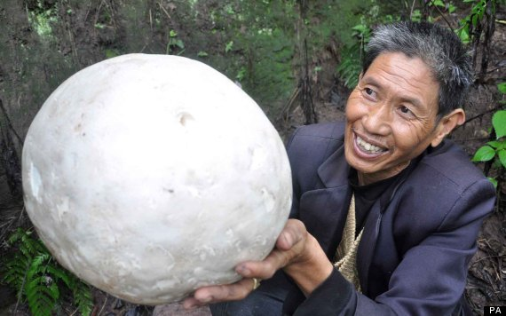
¿Cómo?
¿Dónde?
¿Por qué?
¿Con quién?
¿Qué?
¿Quién?
¿Cuándo?

Slide 44
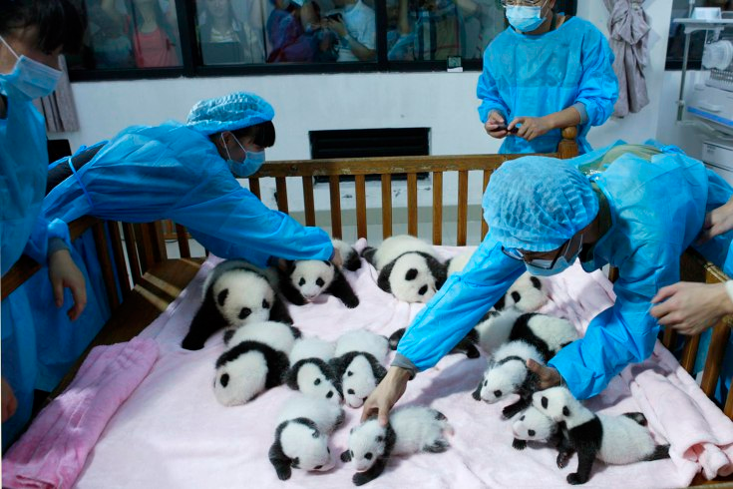
¿C___?
¿D____?
¿P__ ___?
¿C__ _____?
¿Q__?
¿Q____?
¿C_____?

Slide 45
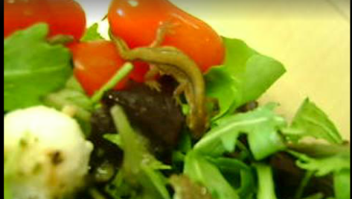
Notes:
http://www.mirror.co.uk/news/weird-news/video-newt-sainsburys-salad-strict-2715607
You can get video snippets as well – best without language (you can turn the sound down if there are words with the story / edit the clip, etc…)
(un tritón in Spanish!)
Veggie Katharine Wood certainly tasted the ­difference when she tucked into her Sainsbury’s salad and found a live newt.
Katharine, 29, was eating lunch at her office desk when she spotted something moving in the leaves.
On closer inspection of her £2.50 mozzarella and tomato bowl she was shocked to see a little newt looking up at her.
Katharine, a finance boss, screamed with horror before rushing to the toilet to wash out her mouth.
She told the Sunday People: “I had already taken about five mouthfuls.
“The thought I’d been ­eating the very leaves where it had been laying and probably urinating disgusted me. I could have actually put it into my mouth.
"As a strict vegetarian it was particularly distressing to find an animal in my food.”
Colleagues at Katharine’s central London office crowded round to see the two-inch newt and filmed it.
She said: “My lunch became the talk of the office. No one could believe their eyes. This slimy newt was moving around in the salad as if nothing had happened.
"I felt upset for it and a colleague and I tried to give it water.”
Katharine then rushed the newt and salad back to Sainsbury’s Holborn store.
Bosses called in an entomologist who identified the refugee as a common smooth newt. The expert said they go into hiding at this time of year.
Customer manager John Jackson said: “It could have buried itself in a crate of leaves destined for the hand assembly bowl line and would have survived the washing process.”
Sainsbury’s apologised and sent a £25 gift card.
But Katharine, of Rochester, Kent, is far from happy.
She said: “I was ill for a week with suspected salmonella ­poisoning, which I now know you can catch from just ­touching a newt.
“This whole experience has ruined my relationship with food , especially salads. I won’t be shopping there again.”
The newt wasn’t feeling too good either and has gone to the salad bowl in the sky.
Sainsbury’s said: “It was in a fragile state. Our supplier planned to release it in the wild but sadly it passed away.”
Sex secrets of a smoothie
The smooth newt is Britain’s most ­common and thrives on a diet of worms, slugs, flies and frog-spawn.
The female mates with multiple males and lays up to 300 eggs. It lives on ­average for six years but can survive until 20 and grow to four inches.
They are often eaten by fish and great crested newts but are protected by wildlife laws from being sold.
Check out all the latest News, Sport & Celeb gossip at Mirror.co.uk http://www.mirror.co.uk/news/weird-news/video-newt-sainsburys-salad-strict-2715607#ixzz2kDlYRPl9
Follow us: @DailyMirror on Twitter | DailyMirror on Facebook

Slide 46
Alternative approaches
Starting with a written / spoken text
Flipped classroom
Translation
Categorisation
Harvesting / transfer from a previous topic
Questions

Slide 47
Alternative approaches to teaching key language at KS3/KS4
November 2013
www.rachelhawkes.com
Notes:
What steps can you take to increase the activity level in your classroom? Approaches to KS3/KS4 and structuring different learning activities for different levels of knowledge.
There is so much that we could look at within this very broad title, but we only have an hour or so, so to chart our way through with a little bit of coherence, I just want us to consider three ideas as a starting point:
1. The standard approaches at KS2 and KS3, and the implications of a potential mismatch in methodology and its impact at transition (if we are not careful).
2. The typical P-P-P model for introducing new language and when / when not appropriate
3. Bloom’s Taxonomy and implications for the way we might want to think about structuring learning sequences.

