Slide 1




3 ways to support progression at KS2
ALL Kent
Languages in Primary Schools
@SylvieBRawlings

Slide 2




Progression through story telling

Slide 3
Progression at KS2…
The national curriculum for languages aims to ensure that all pupils:
▪ ?understand and respond to spoken and written language from a variety of authentic sources
▪ ?speak with increasing confidence, fluency and spontaneity, finding ways of communicating what they want to say, including through discussion and asking questions, and continually improving the accuracy of their pronunciation and intonation
▪ ?can write at varying length, for different purposes and audiences, using the variety of grammatical structures that they have learnt
▪ ?discover and develop an appreciation of a range of writing in the language studied.

Slide 4

Progression through story telling
Story is told very slowly with actions and the
children then join in.
2. In the second session, they listen to the story
on You Tube read by a child of their age:
https://www.youtube.com/watch?v=Rg7mTm2UHWU

Slide 5
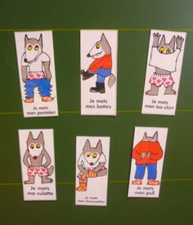
3. They then reorder the story from cards and read it in pairs. (peer assessing and then filmed).

Slide 6

They make their minibook and tell the story to their parents at home.
5. They write a description of their own wolf on white board and then type it in Book Creator.

Slide 7
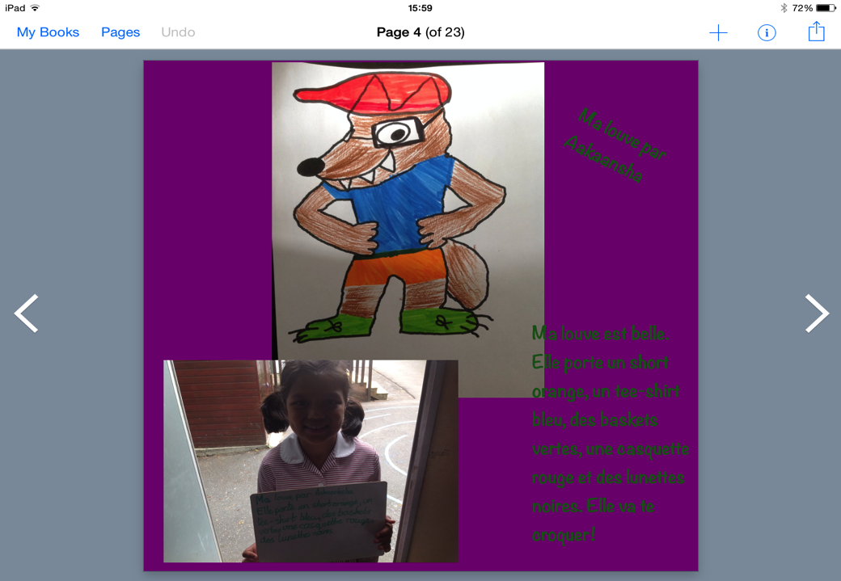

Slide 8
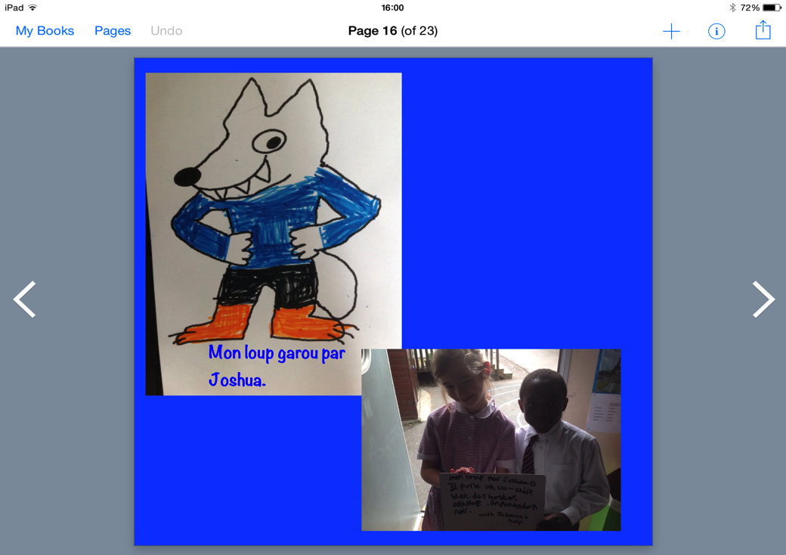
Notes:
Less confident pupils worked in pairs.

Slide 9
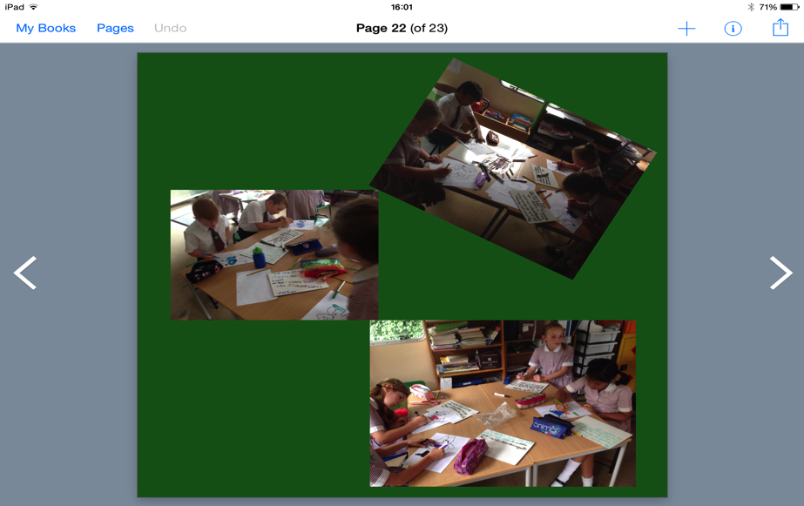

Slide 10

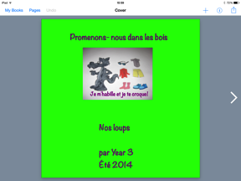
Book creator
Interactive book. You can use not only text and images, but video and audio. If you want to “publish” your book you can always print a PDF version or save it as a movie.
For more ideas: https://musingsfromtheisland.wordpress.com/2014/03/25/culture-and-learning-in-mfl/
Notes:
Book Creator is the app I have used the most in my teaching.
It is such an effective tool and the possibilities are endless!
I have different books on the go to record progression, I tend to save them as movie or pdf. They can also be published and shared in Ibooks.
Rachel Smith’s blog post.

Slide 11

What I used it for?
Who with?
Autorap:
Turns any voice recording into a rap –
you select a tune, record yourself speaking and the app turns it into a rap !
Make up own rhymes/poems/songs using a range of topic and structures previously learned :
Producing a creative piece of writing/speaking.
Link with a school in the North of England.
Barming School Year 4:
eg: http://www.smule.com/p/173503992_35181461
Notes:
.

Slide 12
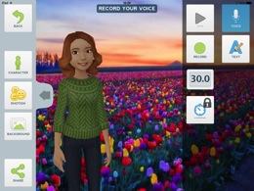



Other Apps
Yakit – ‘Make any picture talk’.‘Bring any photo to life’.
PuppetPals2 – create animated cartoons (storytelling)
Sock Puppets
Tellagami – create an animated characters & record a message.
Follow @joedale on Twitter

Slide 13
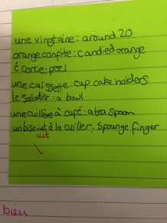
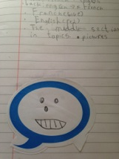
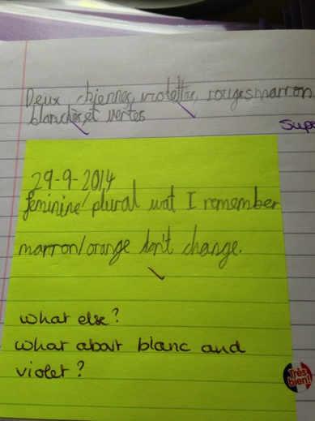
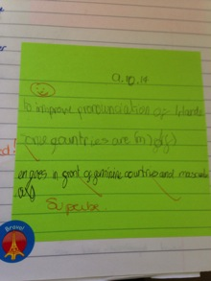
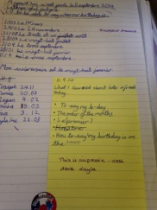
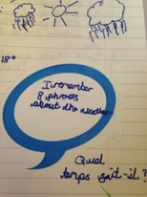
Post it notes

Slide 14
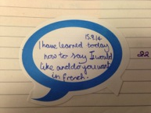

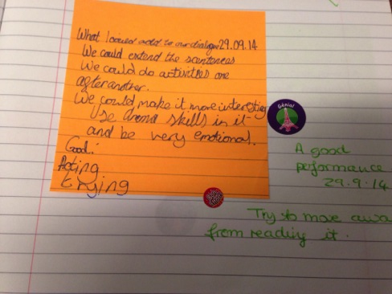
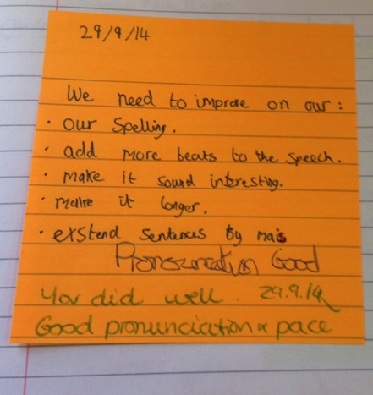
Post it notes

Slide 15
Further reading on progression
Janet Lloyd: Seeing in action: http://janetlloyd.blogspot.co.uk/2015/01/seeing-progress-in-action.html?m=1
Clare Seccombe: http://changing-phase.blogspot.co.uk
http://richmondgovuk.j2bloggy.com/erichmond/languages-3/
National Curriculum: https://www.gov.uk/government/uploads/system/uploads/attachment_data/file/239042/PRIMARY_national_curriculum_-_Languages.pdf

Slide 16
Sylvie Bartlett-Rawlings
ALL Kent
Languages in Primary Schools
@SylvieBRawlings
scbartlettrawlings@gmail.com

