Slide 1
Doing things differently
- building engagement with languages
For more ideas
www.chrisfuller.typepad.com
To chat things over
@chrisfullerisms
To discuss and ask questions
Chrisfullerinspain@hotmail.com

Slide 2
Building engagement
Purpose for learning
Knowing how to develop
Tools to self-express
Engaging content to drive learning

Slide 3
School ethos
Project Based Learning
Overview planned in conjunction with other departments
Student-lead learning
Who’s to blame for climate change?
Life post-earthquake
Guernica + rights of child / democracy
Design 21st century school for rural Bolivia
Emmigration guide
Uruguayan drug legalisation

Slide 4
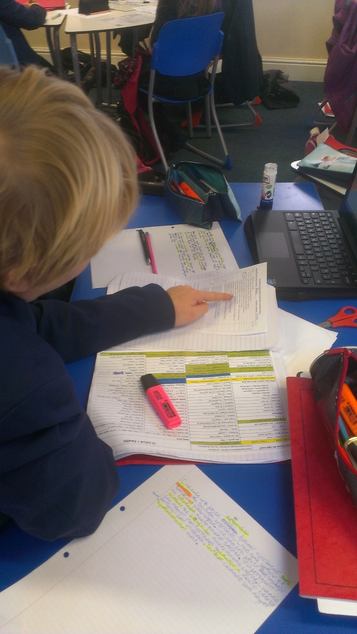
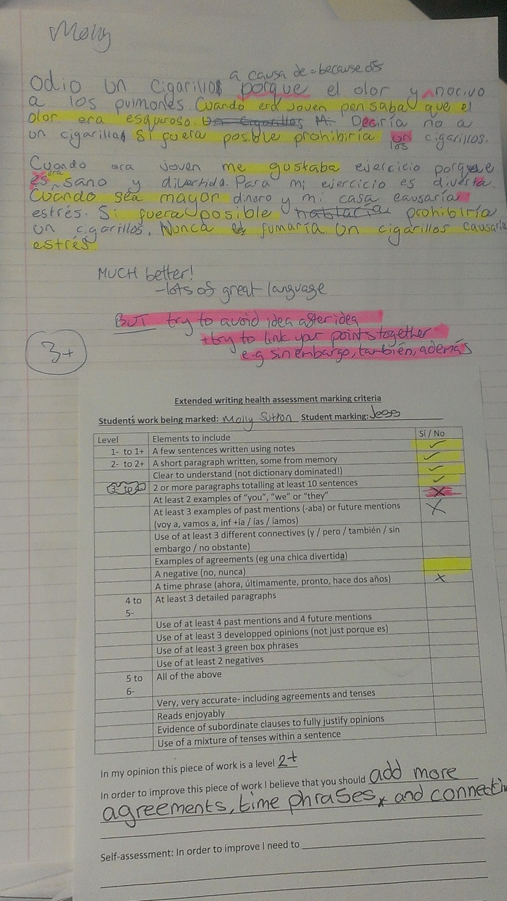
Marking for understanding
Notes:
Pic from book

Slide 5
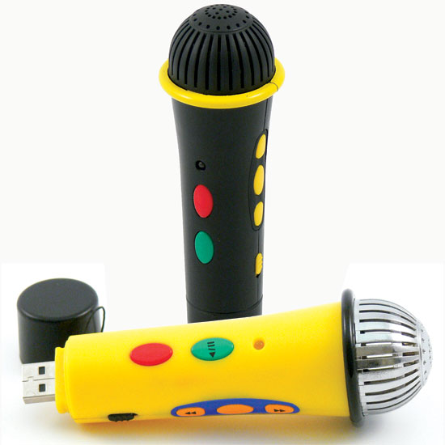
Marking for understanding
Primero en el alfabeto
Segundo en el alfabeto
Tercero en el alfabeto
Cuarto en el alfabeto
20 minutos

Slide 6
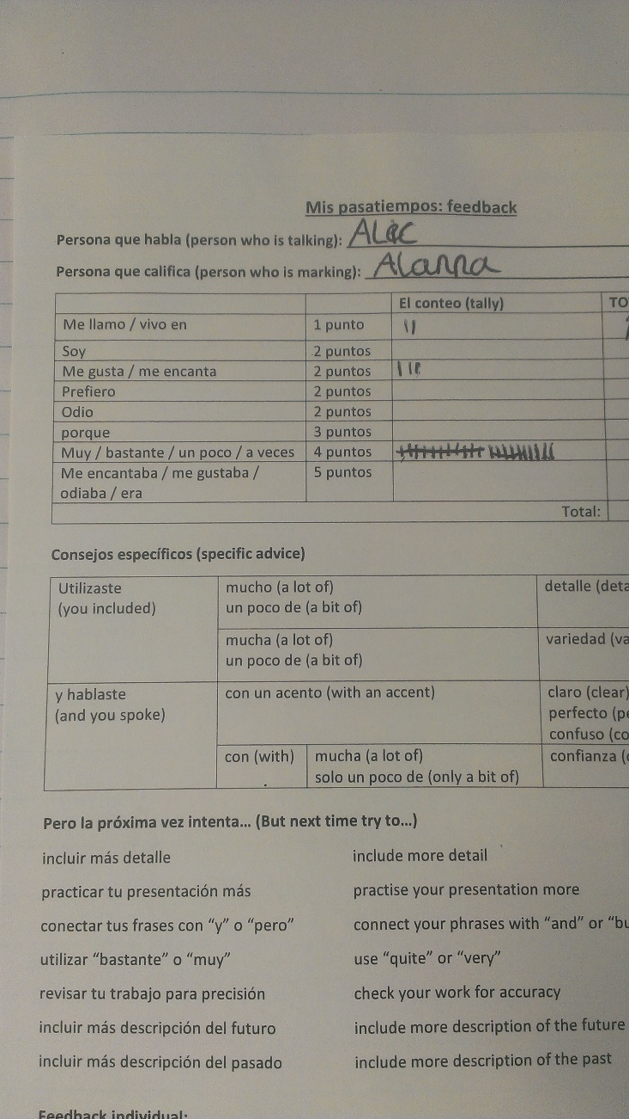
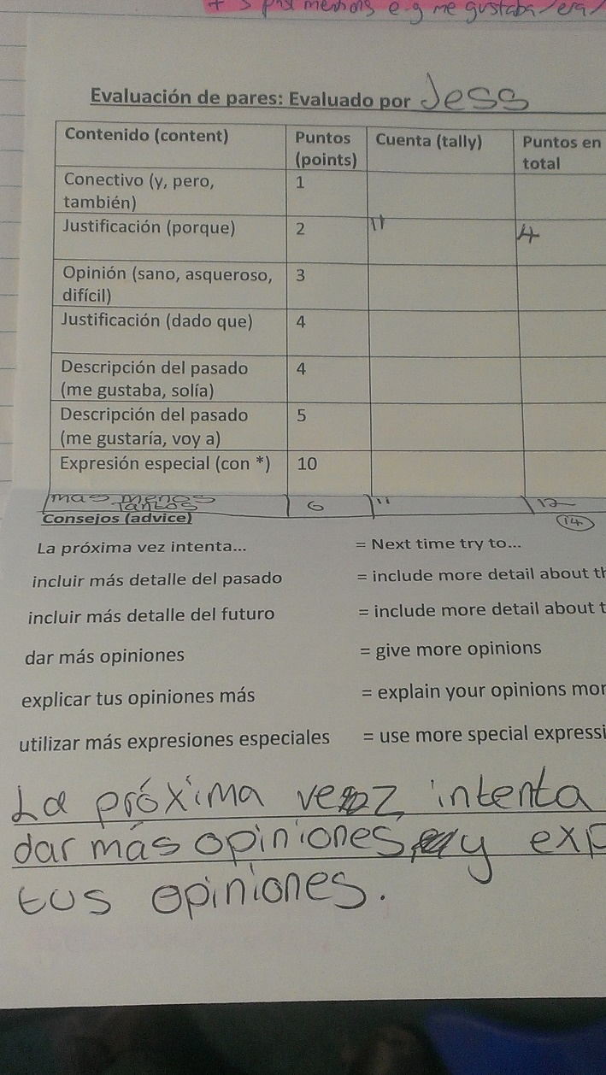
Marking for understanding
Notes:
Peer health form

Slide 7
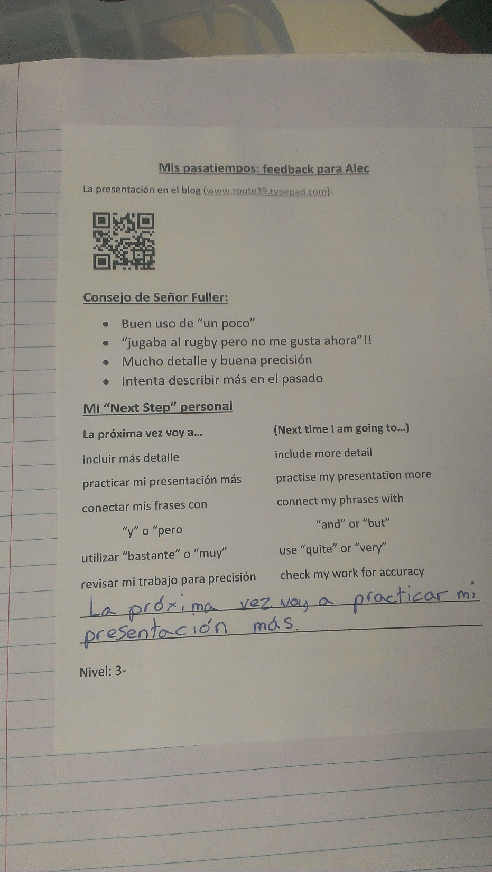
Marking for understanding
bit.ly/QRcodebookmarklet
Notes:
QR form photo

Slide 8
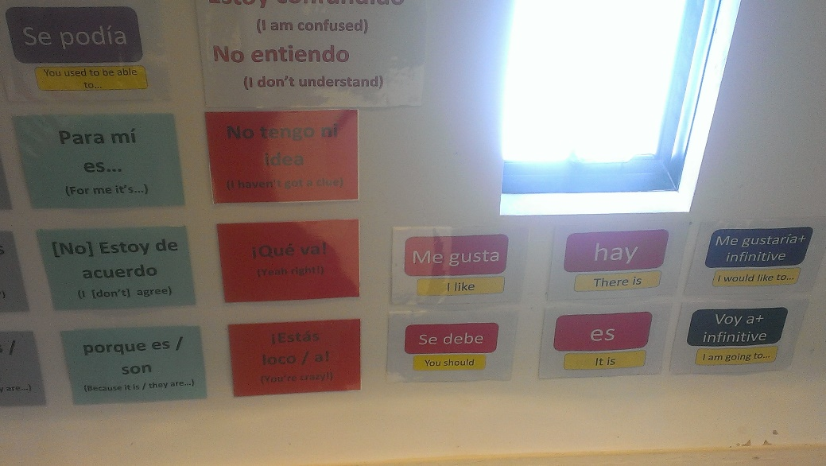
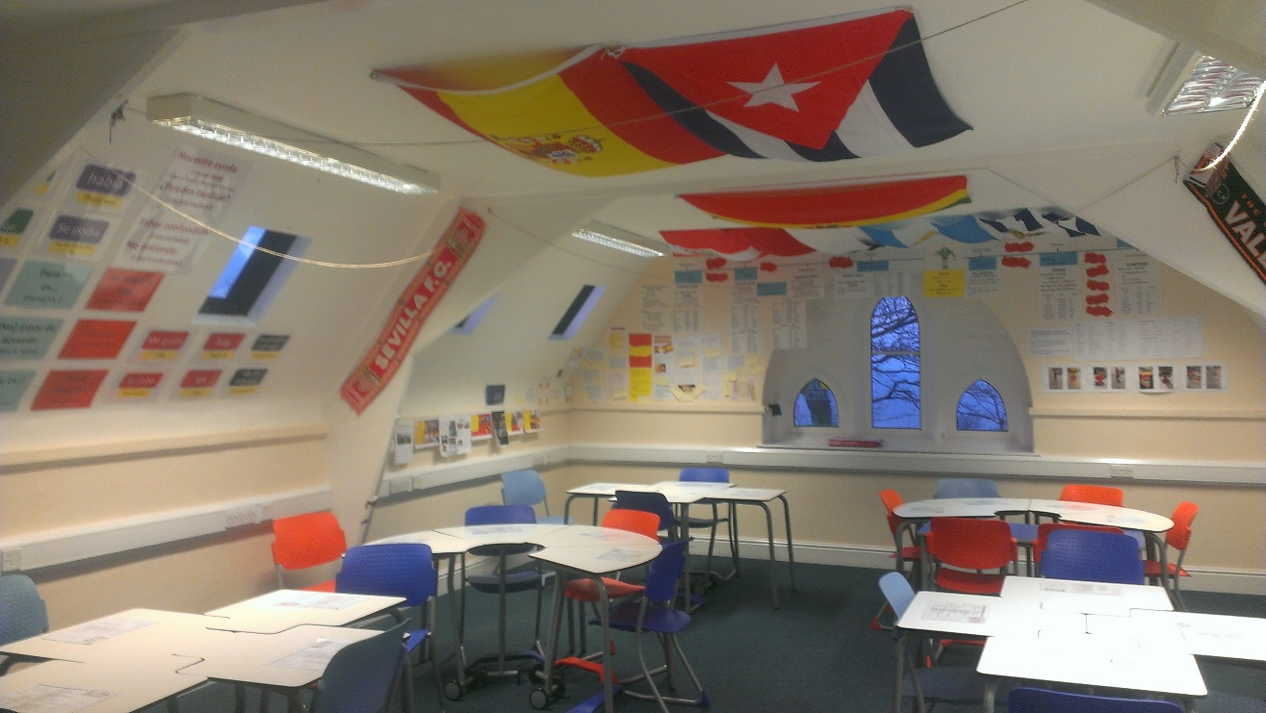
What do students
want to say?!
Notes:
Photo of mindmap

Slide 9
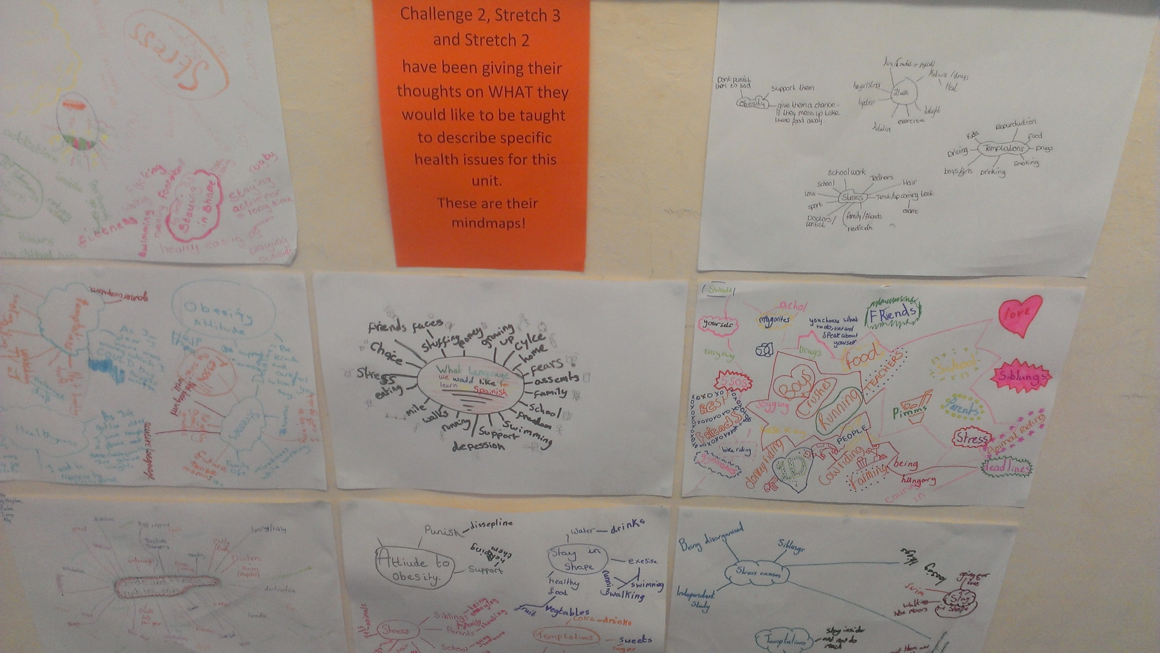
What do students
want to say?!
Notes:
Photo of mindmap

Slide 10
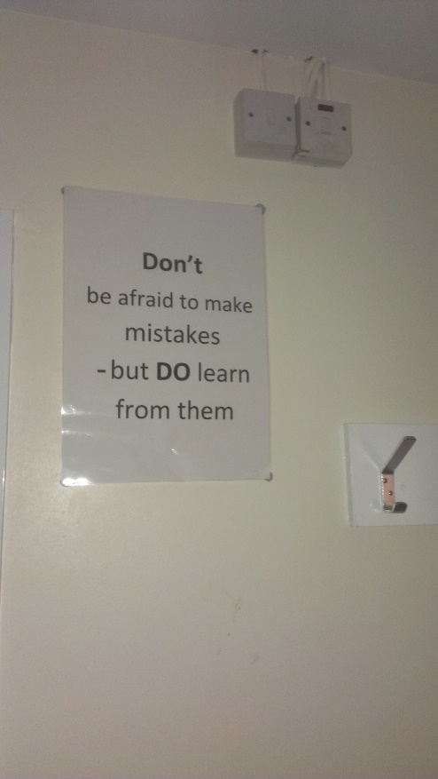
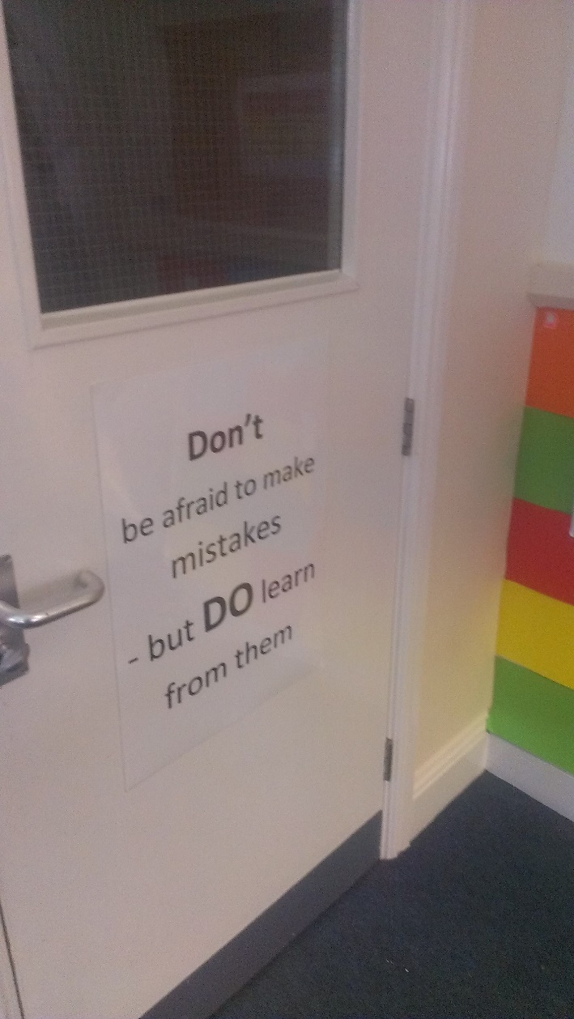
Mistakes are healthy

Slide 11
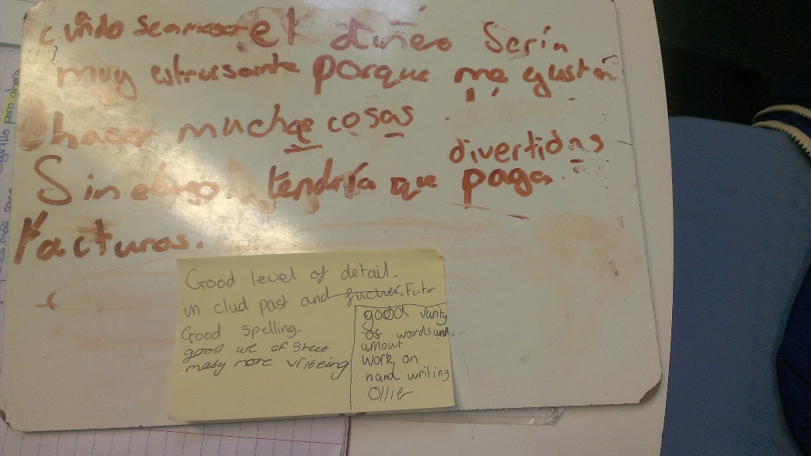
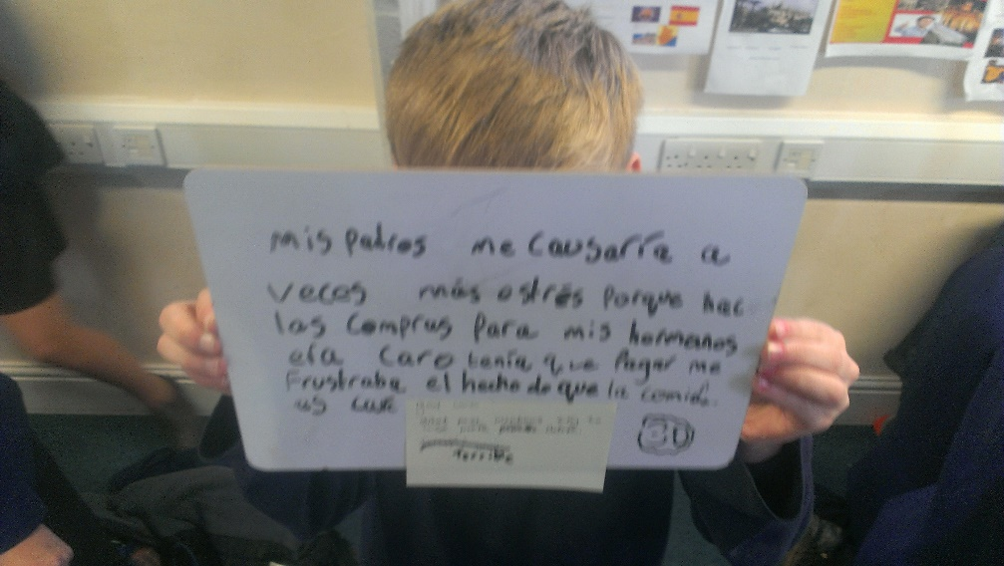
Collaboration for learning
Notes:
Mini-whiteboard slides, wall writing photo, banner on wall

Slide 12
On your mini whiteboard-
Can you develop a
word answer to the question?
¿Cómo fue tu visita al parque acuático?
¿Más difícil? Usa “we -ed…”
20
30
Can you develop a
answer to the question?
¿Más difícil? Usa un adverbio
Incluye 1 de…
Más o menos
Antes de nada
De un lado… del otro lado…
32
50
Can you develop a
word answer to the question?
INCLUDE would you like to do / visit in the future?
¿Más difícil? Usa una pregunta
40 - 50
65 - 80

Slide 13
¿Positivos?
¿Negativos?

Slide 14
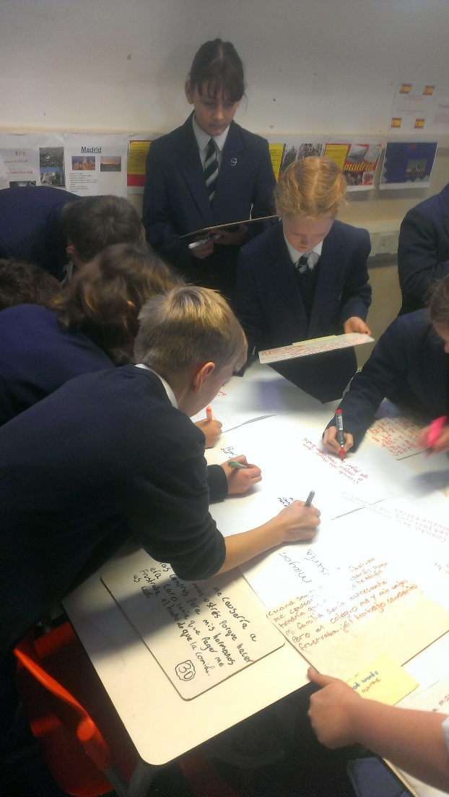
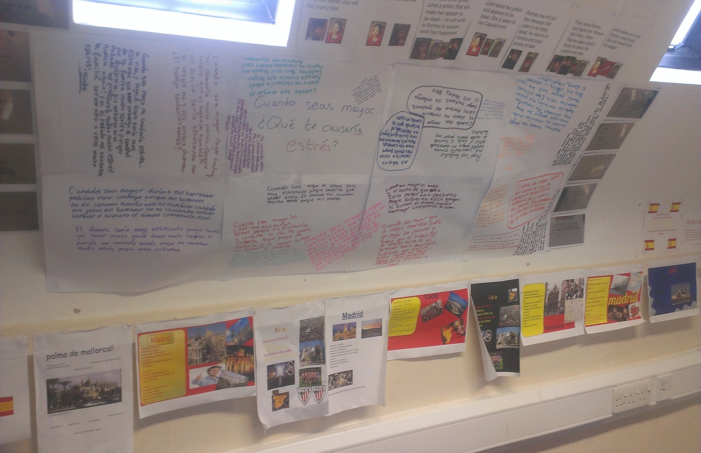
Collaboration for learning
Notes:
Mini-whiteboard slides, wall writing photo, banner on wall

Slide 15
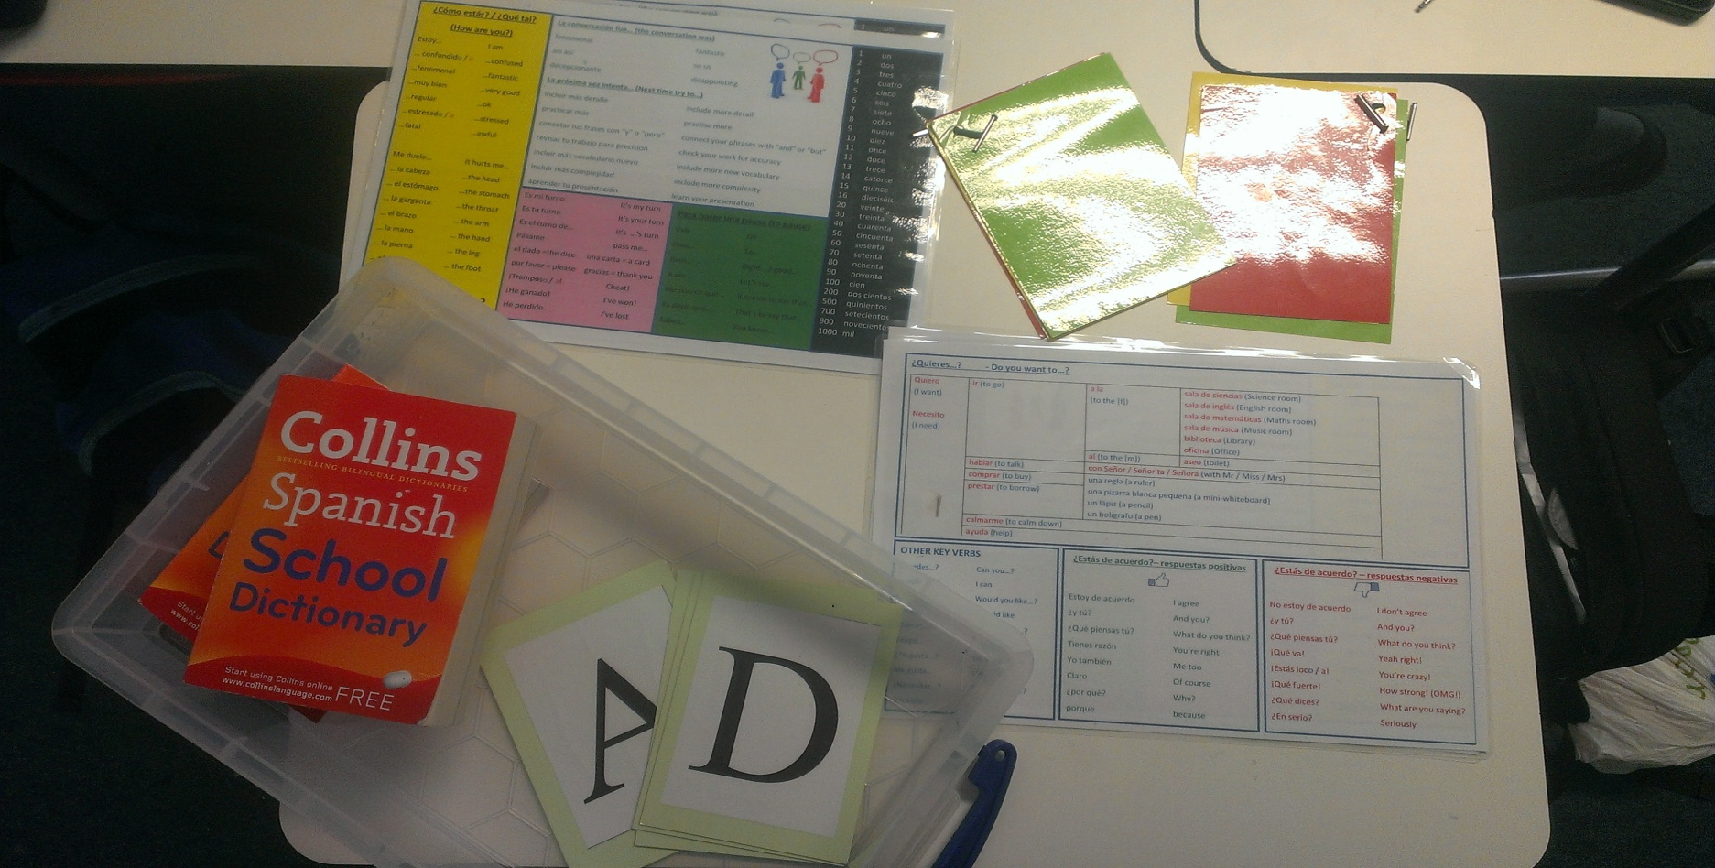
Tools to build
self-expression

Slide 16
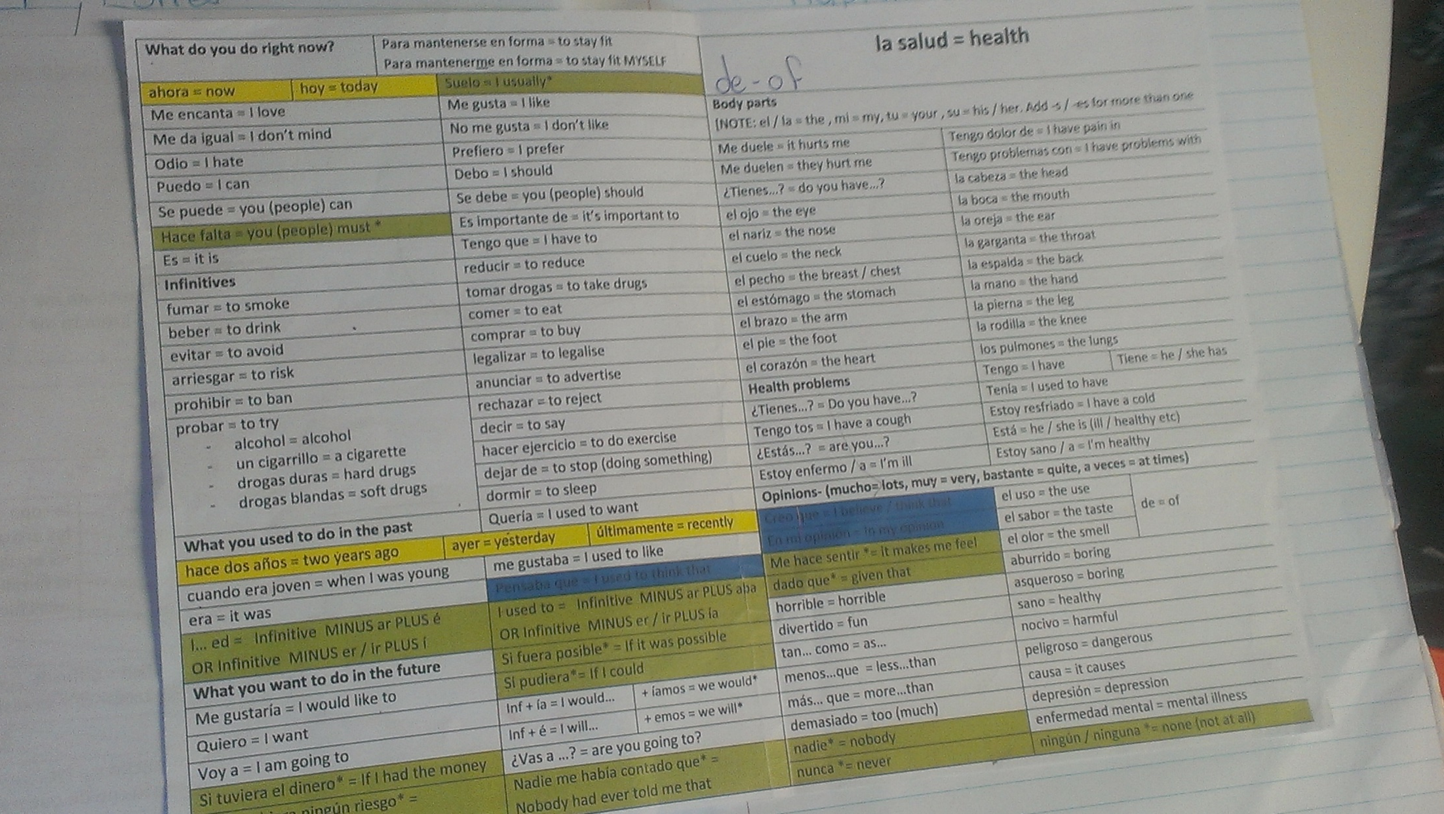
Tools to build
self-expression
Notes:
Word mat screenshot, photo of mindmaps on wall

Slide 17
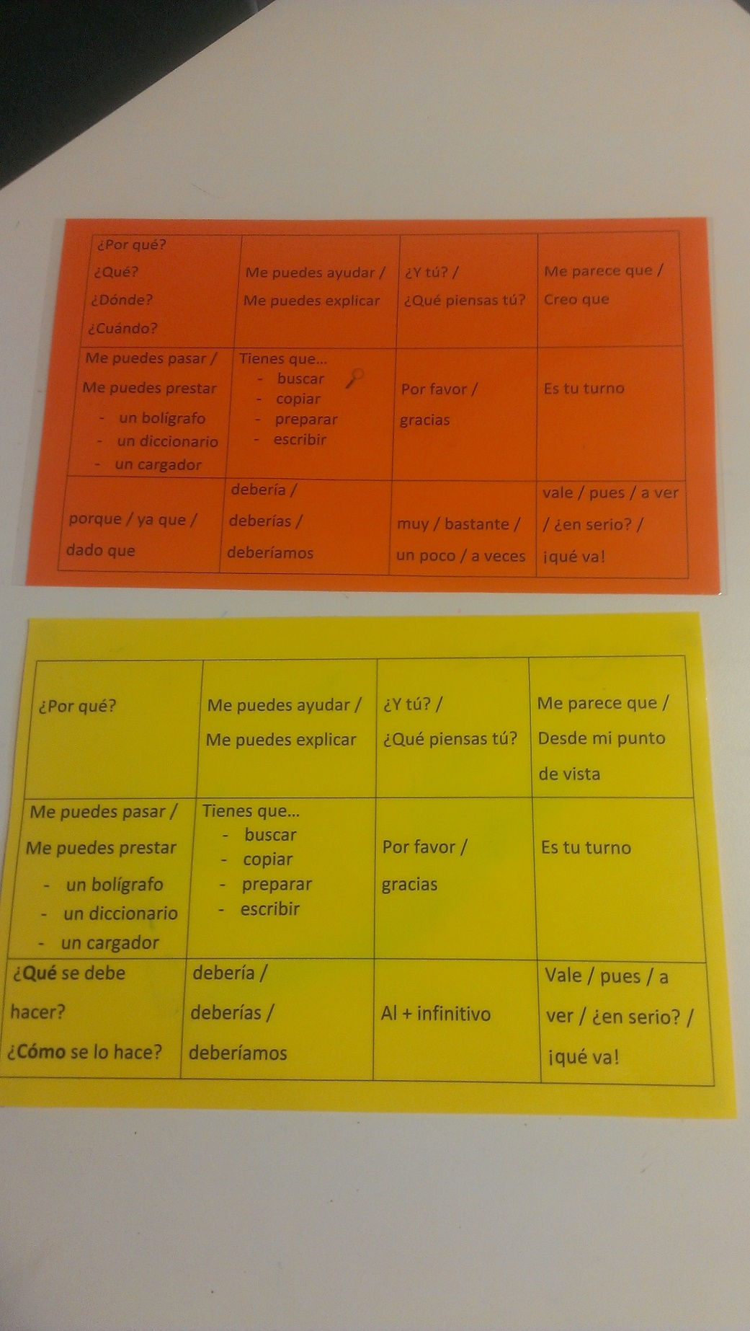
Tools to build
self-expression
Notes:
Word mat screenshot, photo of mindmaps on wall

Slide 18
Who is this and why is he so important for your grammar sessions?

Slide 19
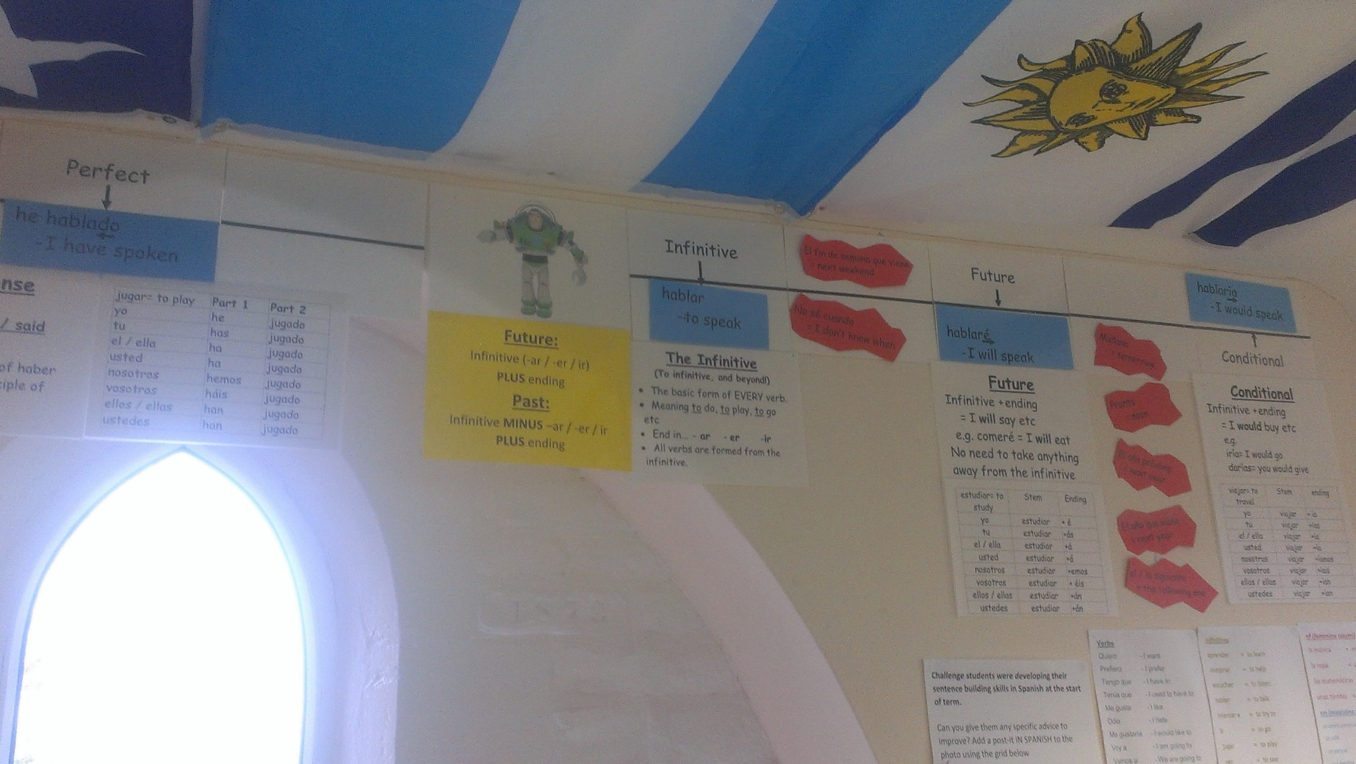
Tools to build
self-expression

Slide 20
Google Forms tracking

Slide 21
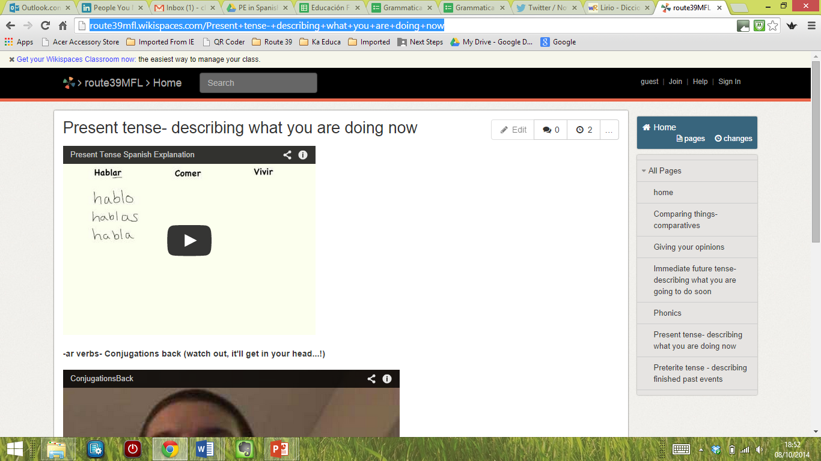
www.route39mfl.wikispaces.com
Organise peer teaching sessions?
Publish students’ teaching resources?

Slide 22
PE in Spanish
Link with Madrid

Slide 23
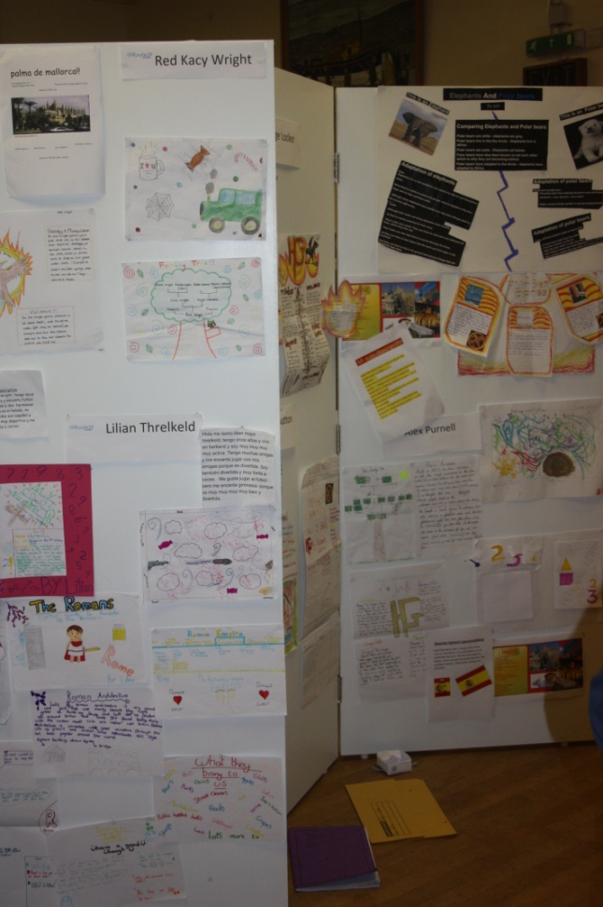
Celebrate it!
Project celebration evenings

Slide 24
Celebrate it!
Make a product of it

Slide 25
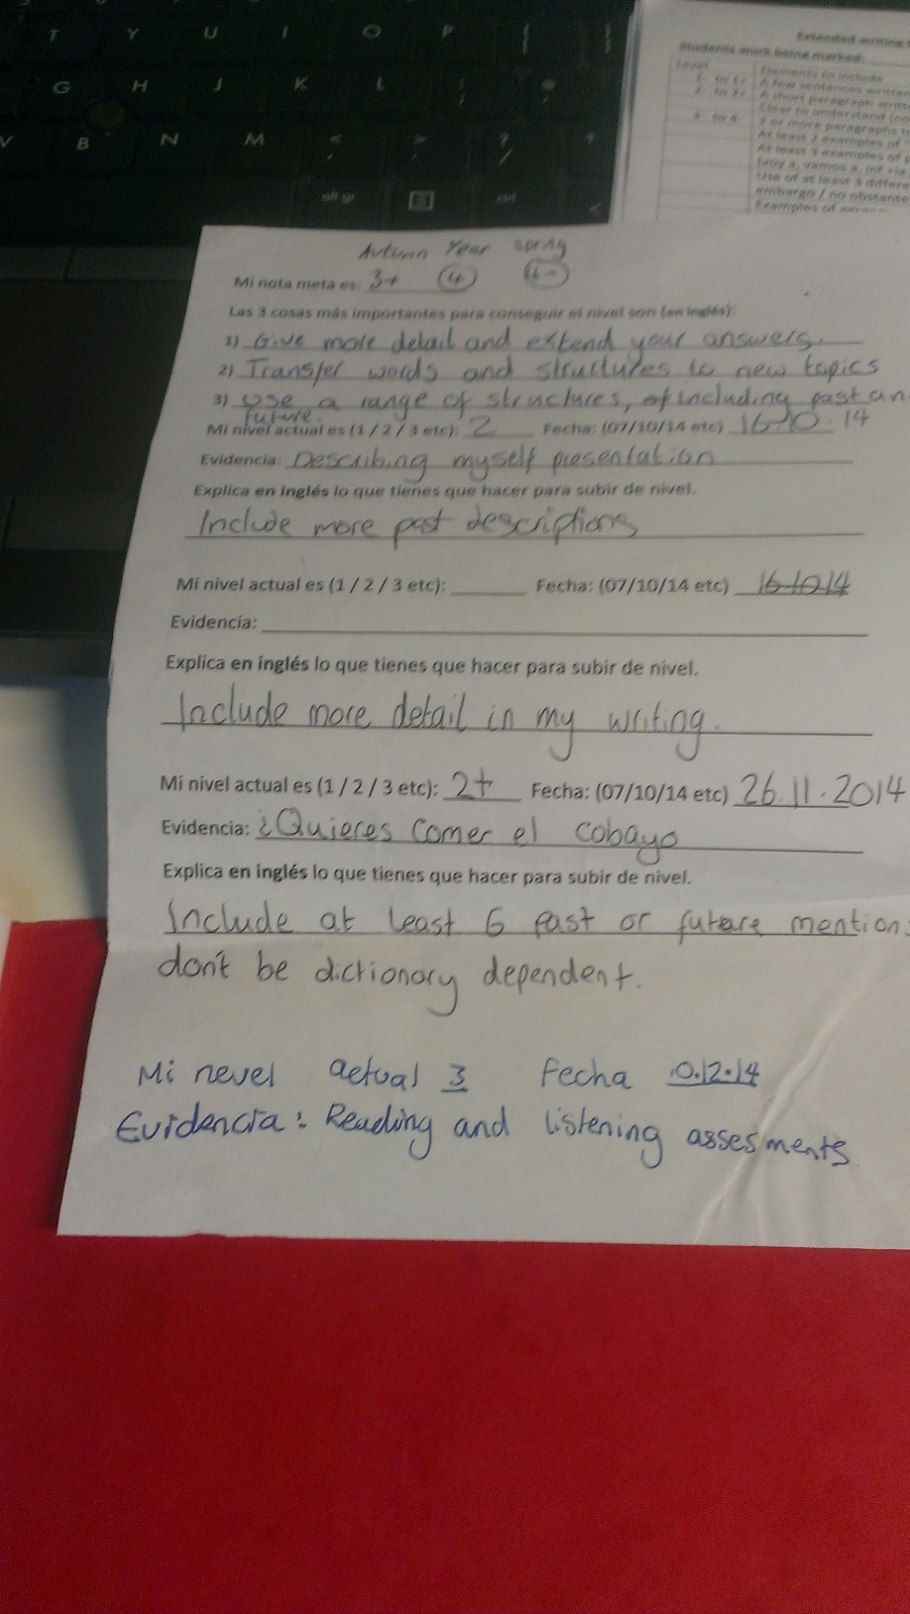
Getting everywhere...
Notes:
Target sheets

Slide 26
Getting everywhere...
Notes:
Lunch menus

Slide 27
Projects to excite!

Slide 28
Cinema speed chatting

Slide 30
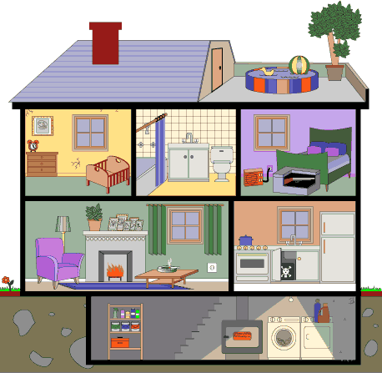
What did you do in your bedroom last night?!

Slide 31
http://bit.ly/Shelterboxchallenge

Slide 32
Run with
Kelda Richards, @elkel99

Slide 33
Your project brief
Exeter City FC is interested in signing a 26 year old French striker on a free transfer.
Leyton Orient and York are also both interested.
He left Ligue 3 club Strasbourg at the end of last season after 4 years, scoring 56 goals in 148 games.
He is married with 3 children (aged 7, 5 and 2)

Slide 34
Your 2 challenges today
Challenge 1
Create a multimedia video in FRENCH to attract the striker to Exeter City- no longer than 2 minutes.
This video will be uploaded to a blog
www.europeandayoflanguages2013.wordpress.com
The video with the most views by 12 midday, Wednesday 2nd October will win.

Slide 35
Your 2 challenges today
Challenge 2
Create a separate, different presentation in FRENCH to lure the player in person- no more than 3 minutes.
You will be presenting this in front of the other teams at 1.00 THIS AFTERNOON.
This must be business-like. You will be cut off at 3 minutes and all team members must speak.

Slide 36
We are looking to run this across various venues next year- anyone interested?
Going forwards
When you leave today it will be YOUR responsibility to develop to drive traffic to your video.
Ideas...
Posters around school
School website?
QR codes?
Speak to family / friends / neighbours

Slide 37
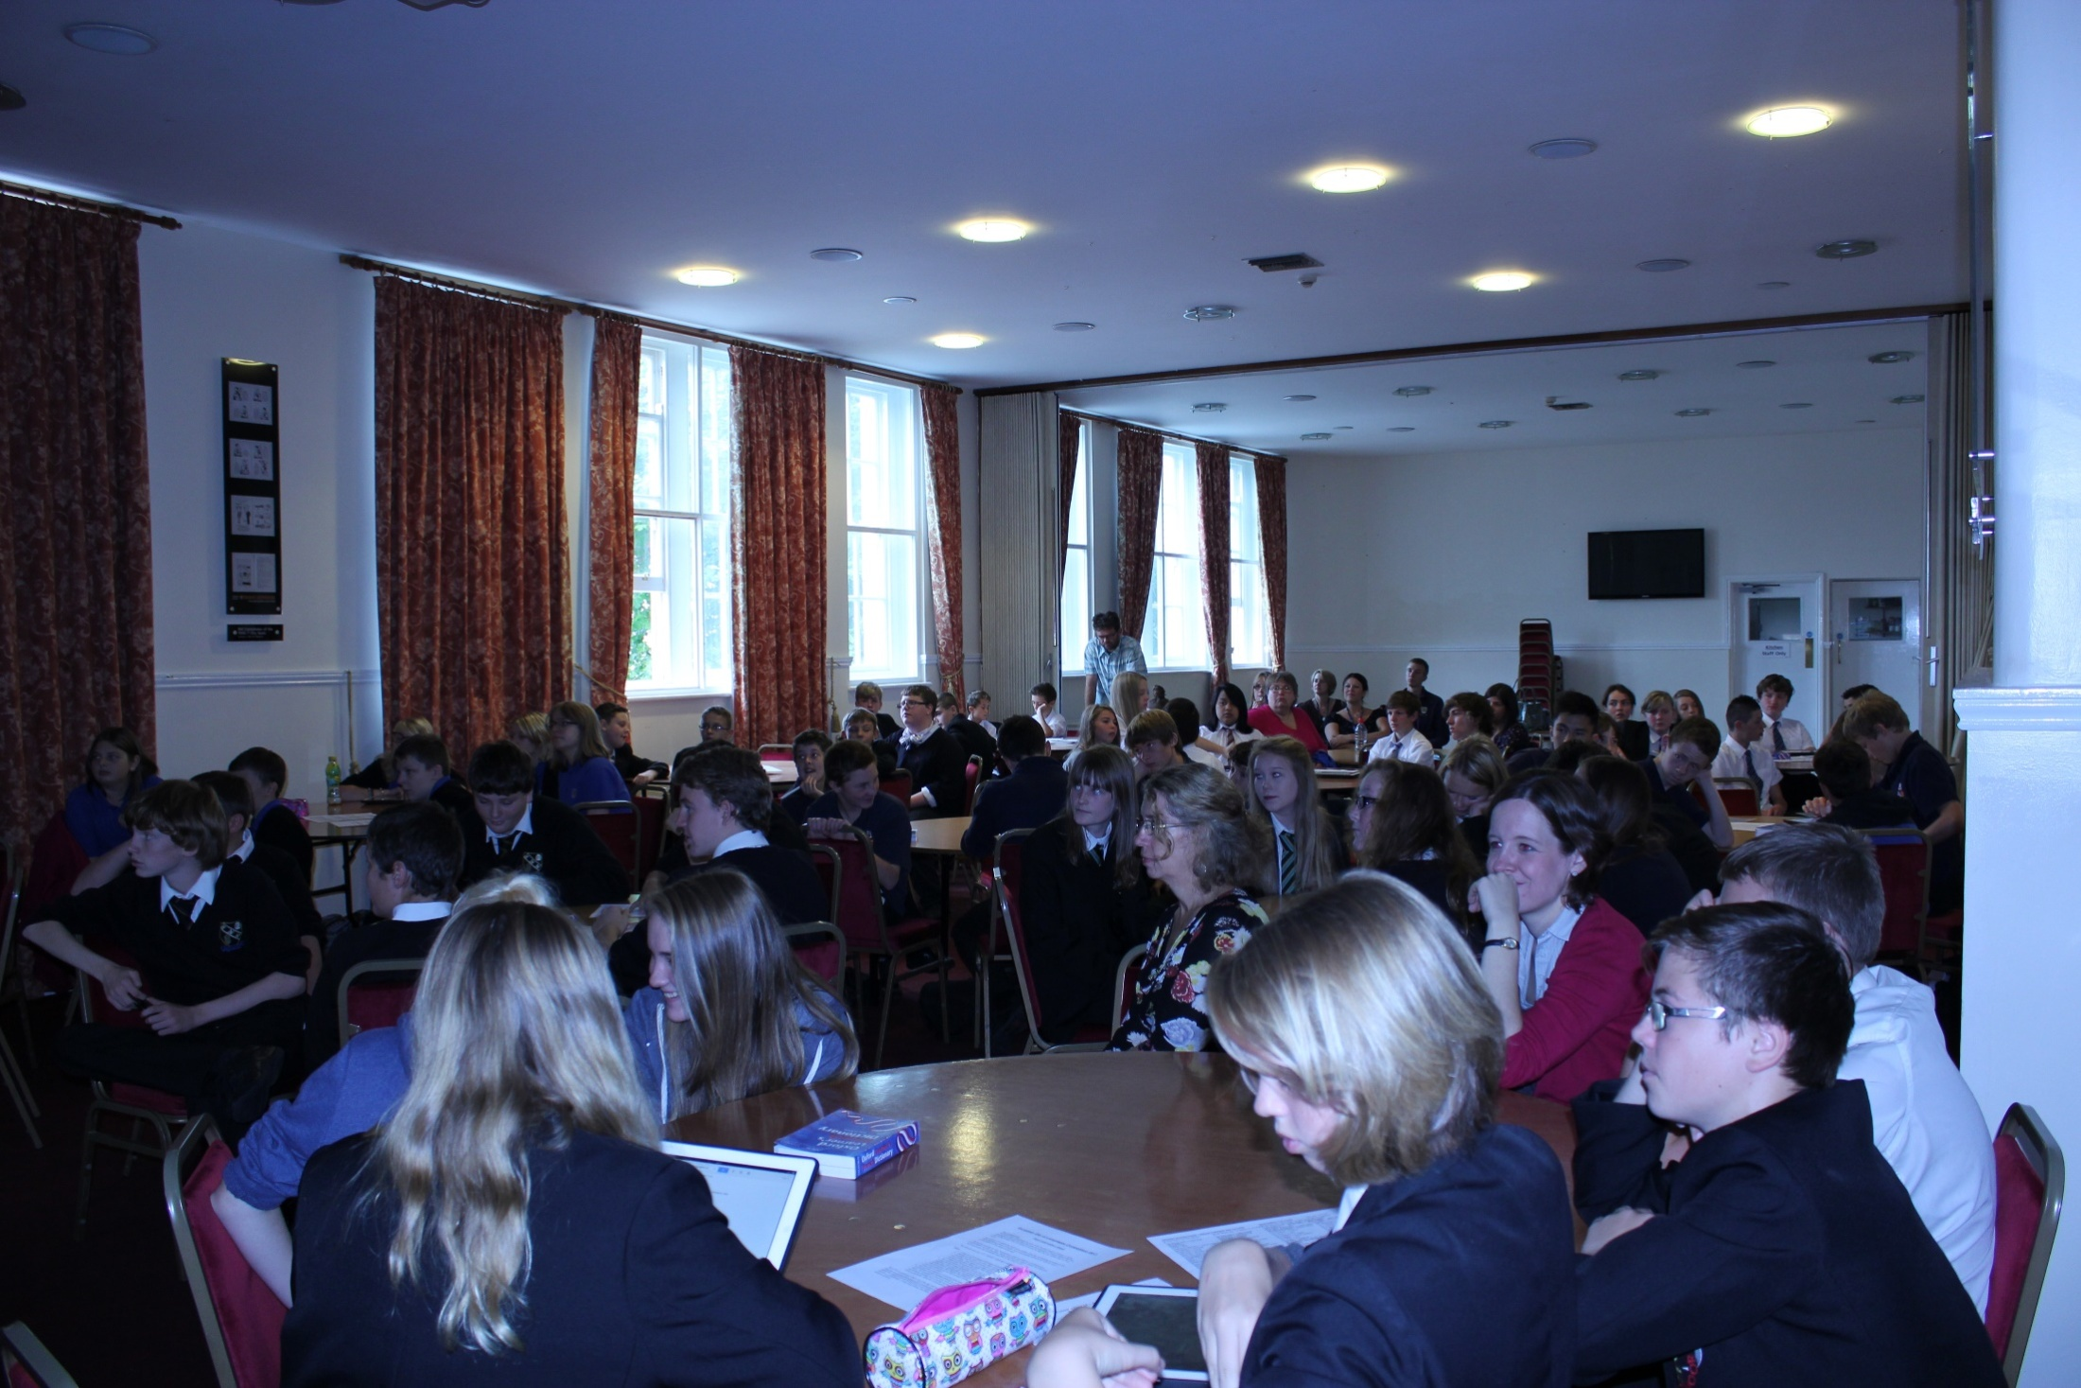

Slide 38
Technology
- Engaging with the world

Slide 39
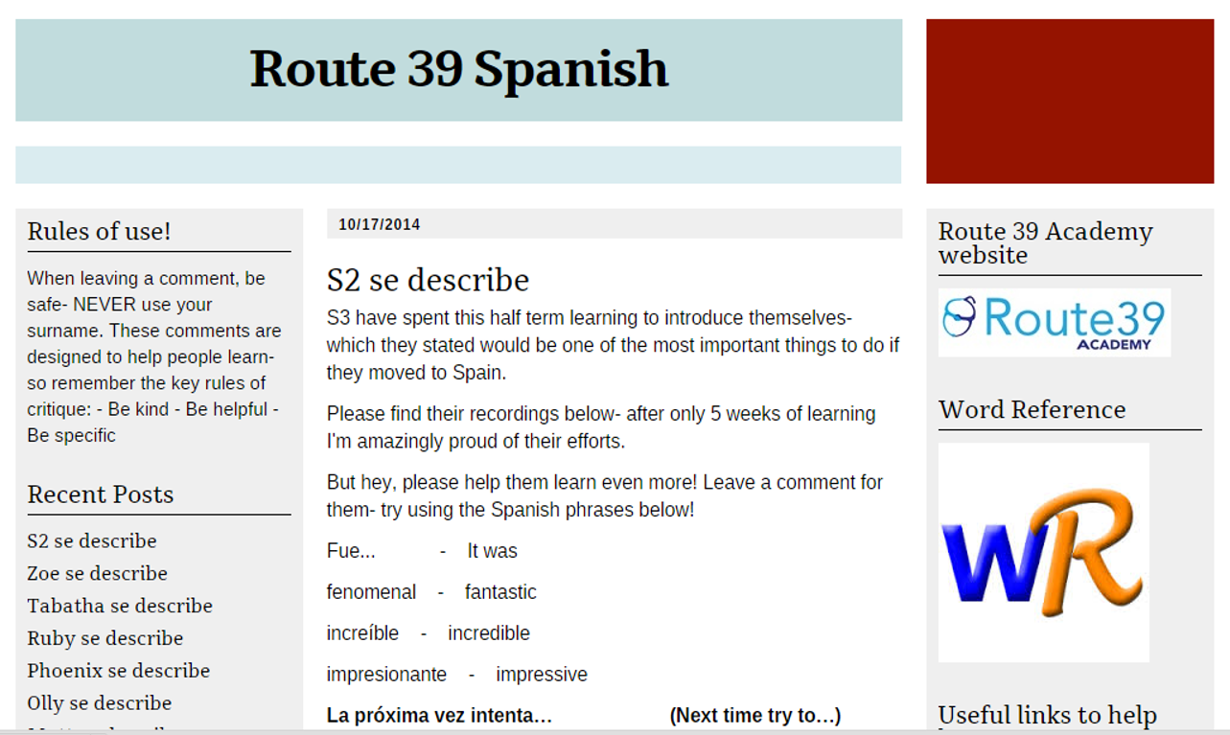
www.route39.typepad.com
www.dragonfly-training.co.uk

Slide 40
www.route39.typepad.com/spanish

Slide 41
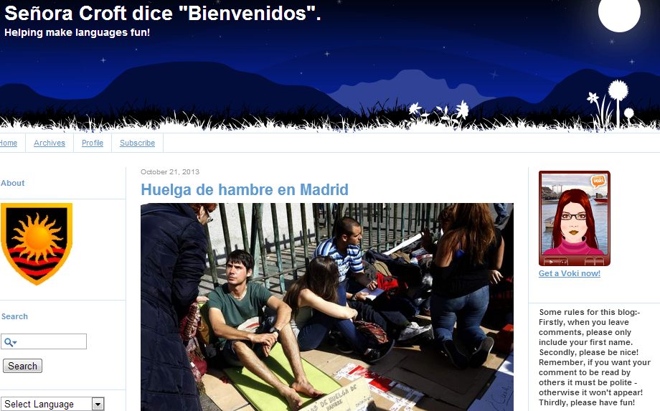
www.ridgewaylanguages.typepad.com
www.dragonfly-training.co.uk

Slide 42
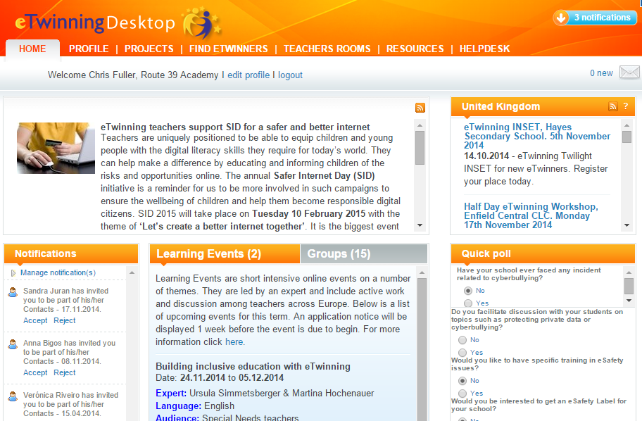
eTwinning
www.dragonfly-training.co.uk

Slide 43
eTwinning

Slide 44
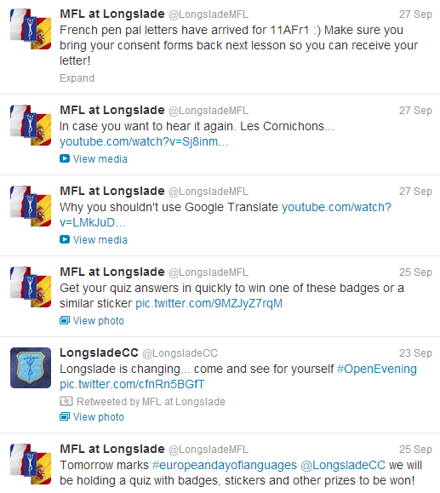
Departmental Twitter accounts
@longsladeMFL
Possible uses
Share links
Reminders
Highlight great work
New blog posts
Building audience
www.dragonfly-training.co.uk

Slide 45
Podcasting
Provides audience for speaking tasks
Immediate (grammar) revision tool
Editing process = repeated exposure
Easy to access anytime, anywhere
By students
Immediate (grammar) revision tool
Easy to access anytime, anywhere
For students

Slide 46
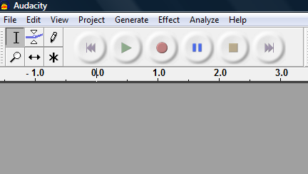
Audacity for editing

Slide 47
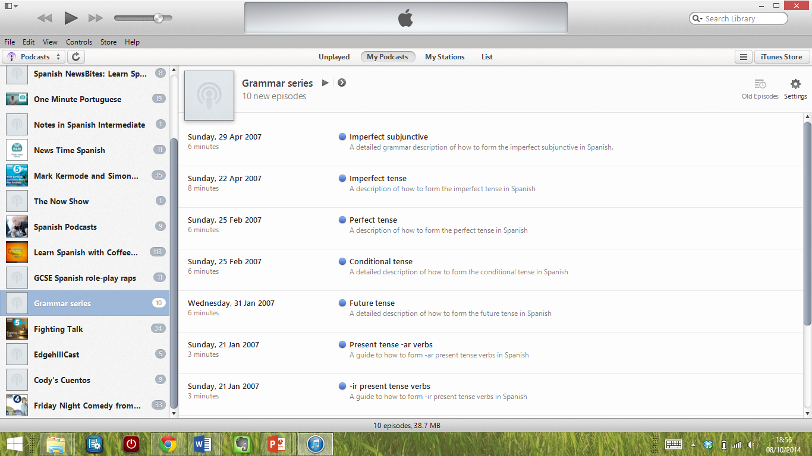
Create your own iTunes account

Slide 48
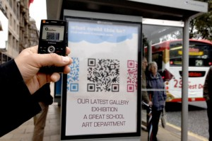
QR code displays
http://bit.ly/QRcodedisplay

Slide 49
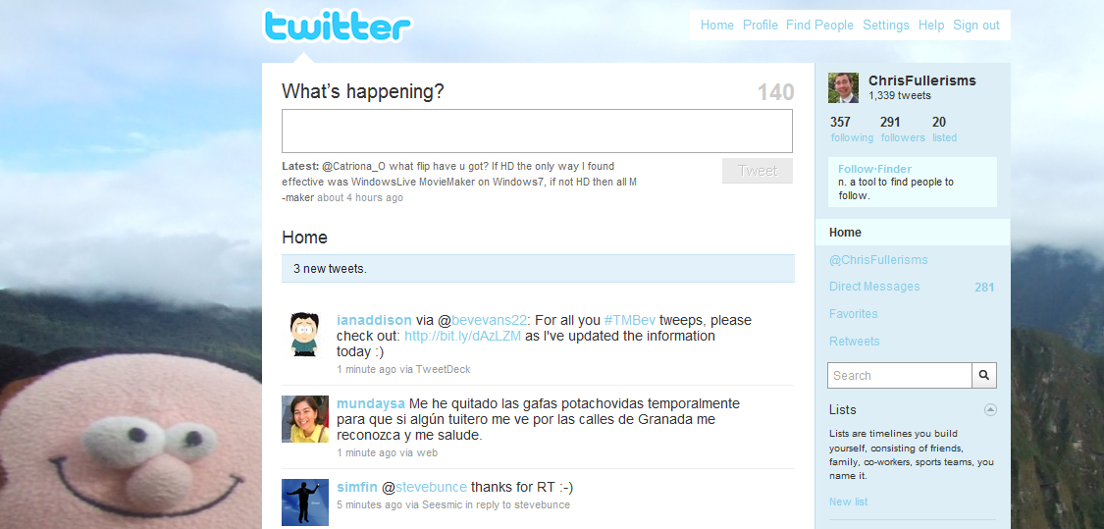
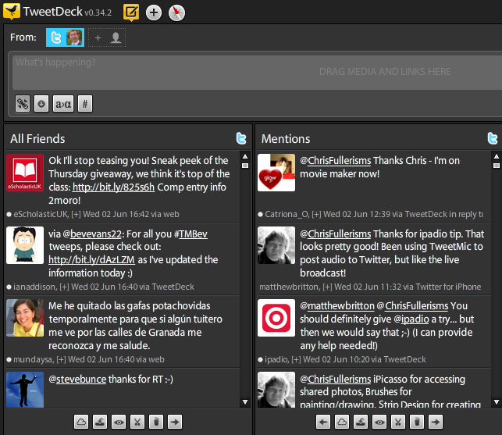
Twitter
- your personal support network
http://tweepml.org/MFL-Twitterers

Slide 50
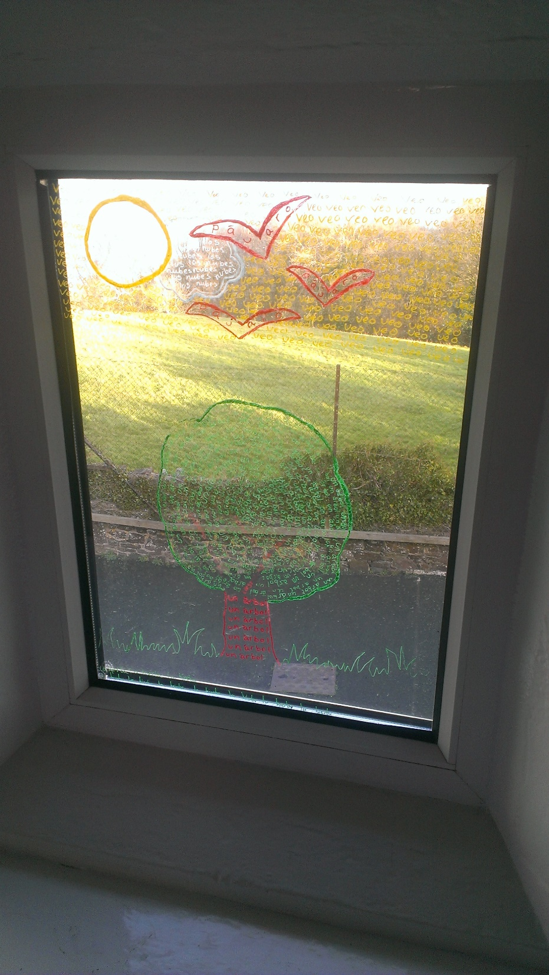
Still worried they’re staring out the window?
Notes:
Photo of windows

Slide 51
Doing things differently
- building engagement with languages
For more ideas
www.chrisfuller.typepad.com
To chat things over
@chrisfullerisms
To discuss and ask questions
Chrisfullerinspain@hotmail.com

