Slide 1
Linguistics in and beyond the languages classroom: how and why
Sarah Campbell
ALL London webinar
14th July 2015
Notes:
5 mins to include introduction and aims

Slide 2
medsols
motsols
pjäs

Slide 3
Today’s session…
Linguistics – what and why?
Linguistics every day – enhancing MFL teaching by encouraging pupils to think like linguists!
MFL and beyond – using linguistics for ‘cross-linguistic’ collaboration, enrichment and intervention, and broader cross-curricular work.
Resources and support.

Slide 4
What…?
Phonetics
Orthography
Language acquisition
Syntax
Morphology
Descriptive vs prescriptive
Language
Systems
Grammar
Speech and writing
Accents and dialects
Social variation
Pragmatics
Lexis and semantics
Historical linguistics
Language futures
Language change
Etymology
Language Varieties
Vocabulary and Language Change

Slide 5
Why…?
encourages pupils to value language for language’s sake
provides practical, transferable language skills
allows pupils to recognise the breadth of language study whilst supporting curriculum requirements
improves pupils’ ability to hypothesise, analyse and synthesise
develops collaborative and teamwork skills
helps pupils better understand relevance and cultural significance of communication in its many forms
raises profile of language as a credible subject matter for investigation, including scientific investigation
supports Key Stage 2 / 3 transition, particularly in MFL
Notes:
5 mins
“…developing critical inquiry” Wayne O’Neill LIS p25
Look at LILT and Hawkins Language Awareness stuff

Slide 6
Linguistics every day
Use these four areas to create linguistics prompt questions
Talk about language – without the ‘s’!
Use linguistics to
‘zoom in and out’ of texts
Discuss linguists with pupils – who are they? What do they do?
Use discussion to foster a love of language for its own sake. Pupils can learn about language as well as learning a language.
Language
Systems
Grammar
Language Varieties
Vocabulary and Language Change
Use a ‘little and often’ approach
Introduce pupils to linguistics terms and concepts so they become part of your every day classroom language.

Slide 7
How many ways can you find to spell the sound ‘ee’?
Can you find a sentence with two clauses?
Can you find three words with prefixes?
What can you say about the longest word in the text?
Do you see any examples of ‘bad grammar’? What do you think about it?
Do any words contain sounds we don’t use in English?
Do you see any examples of particularly modern / old fashioned words? What would you say instead?
Is this a formal or informal text? How do you know?
How would you describe the speakers’ voices? Why?
Do the speakers have the same accent?
Divide the words up into semantic fields.
How would this text be different if it happened ‘in real life’?
Find three words in the text and exchange them for their antonym. How does this change the text? What else do you need to change to make it make sense again?
Notes:
Can also be done in TL to broaden pupils’ spontaneous speech – a way of practising that skill – particularly relevant for new GCSEs

Slide 8
@Bessedyaszay Bare yutes shooting at the feds #tottenham
You can look inwards to the words.
Orthography
Morphology
Phonology
Semantics
Syntax
You can look along to other texts.
You can look outwards to the world.
What kind of text is this?
How does this text relate to other texts / types of text?
How is our reading of this text influenced by other types of text? (intertextuality)
What is this text telling us about?
What role does this text play in the world?
Why did the author produce this text?
What does the language tell us about the author?

Slide 9
Does this text contain any borrowings or other type of influence from another language?
How does the umlaut make the pronunciation of ‘für’ differ from that of ‘nur?
What does this text tell us about the role of communication in today’s society?
What is the origin of the word ‘simsen’ Why is this interesting?
What is the role of the text itself? What is its intended effect?
Imagine a different person in the picture – would the language be any different? How? Why?
What syntactic features are used in advertising to make them effective?
What kind of advert is this?
What other types of advertising exist?
Are they more or less powerful than this? Why?

Slide 10
The value of a linguistics approach for KS2/3 transition
Transition age pupils have been found to be most receptive to learning about language ‘for language’s sake’
“ In our experience we have found that younger students are far less infected than older students and adults by the strictures of prescriptive grammar… They do not resist the notion that there is a linguistics, a science of language and of mind…..”
Honda, M., O’Neil, W. and Pippin, D. “On promoting linguistics literacy” in Denham, K. and Lobeck, A. (ed.) “Linguistics at School” (2014: 178-9)
A linguistics approach supports the increasingly popular ‘multi-lingual’ / language awareness model of language teaching at KS2 (see eg. Peter Downes’ Discovering Language project)
A linguistics approach supports the National Curriculum ‘POS’ for KS2 and 3, in particular “Language teaching should provide the foundation for learning further languages…”
Notes:
5 mins

Slide 11
MFL and beyond…
‘cross-linguistic’ collaboration
collaboration with English / Classics departments on language work
enrichment and intervention
linguistics offers much scope for pupils to develop and improve transferable skills such as problem solving, teamwork, critical thinking, analysis, etc, so would work well for G&T or SEN intervention work, or for a themed day
broader cross-curricular work
US middle school teacher David Pippin’s work has shown that linguistics can be a serious subject for scientific study in the classroom
Socio- and historical linguistics can offer different perspectives in citizenship, history and geography lessons.

Slide 12
‘Cross-linguistic’ collaboration
Interest in collaboration between different types of language teachers is currently gaining pace, particularly in the field of grammar teaching. Collaborative work on language can be broadly defined as:
All forms of language and linguistics related teaching which has the aim of raising the profile of, and pupils’ interest and ability levels in language, and in which there is collaboration between linguists of different types, and / or standalone teaching about language which contributes to knowledge and skills in, but is not necessarily overtly presented as, English, Classics or MFL work’

Slide 13
Ideas for implementing cross-linguistic collaboration
Cross curricular ‘domino’ starters and plenaries / homework
Cross curricular pupil ‘envoying’
‘Cameo’ teaching / team teaching or joint ‘reflect and extend’ lessons after separate work on a specific area of language
‘Crowdsource’ examples of grammatical features from pupils’ home languages, allowing pupils to deepen their understanding of features through comparison
Develop pupils’ metalanguage by getting them to create their own grammar glossaries with examples from different languages
Terminology bingo cards – pupils tick off features in return for merits when they have heard items of grammatical terminology mentioned in MFL, English (and Classics where applicable) and can explain / exemplify the feature
Set cross curricular ‘language journals’ as an ongoing homework, with pupils recording noteworthy eg. grammatical, lexical, sociolinguistic examples they use, hear and read
Use English and FL versions of children’s books for parallel linguistic analysis.

Slide 14
Linguistics resources
Global Communications is a fully resourced three-unit linguistics course for Key Stage 3 pupils www.globalcommseducation.weebly.com
Professor Kristin Denham from Western Washington University has made many articles / resources available on her websites
www.kristindenham.net/#!ling-in-ed/c1sju
www.teachling.wwu.edu/
www.explorelanguage.org/
‘Lingo’ is a new language and linguistics magazine for KS2 and 3 pupils from the producers of Babel. You read the first issue free online at http://www.lingozine.com/read-a-free-issue.html
Mick Webb’s ‘The Book of Languages’ is a great source of KS2/3 level language information. David Crystal’s ‘Cambridge Encylopedia of the English Language’ is highly detailed and informative for older year groups or for teachers.

Slide 15
Group these examples of language into three categories and give each category a title or description.
1 A mum sings to her child to help him stop crying.
2 A teacher tells the class what their homework is.
3 A granddad refers to his granddaughter by a family nickname.
4 Two best friends invent a secret code to speak in.
5 A policeman reads the arrest statement to a suspected criminal.
6 A shop assistant tells a boy how much a DVD costs.
7 A bully swears at a classmate and says he can’t join in their football game.
9 A lady says ‘good morning’ to her neighbour in the street.
8 A teacher points at a class and says ‘ssshh’ when they have been misbehaving.
12 A guest on a TV show does not speak until the host asks her a question.
10 A TV presenter reads the weather forecast.
11 The council put up a ‘No Ball Games’ sign outside some flats.
15 A doctor reads a patient’s notes and discusses them with the nurse.
13 A girl puts two kisses and a smiley at the end of text message to her friend.
14 The winning lottery numbers are published on a website.
What does the language in each category do?
Do some of the statements fall into more than one category? Why?
Can you think of other examples for each category?
Notes:
The slide could be printed out for pupils, and the various examples cut out for sorting.

Slide 16
Now look at the sentences from other languages.
Try to colour code them appropriately:
Nouns in red / Adjectives in blue / Pronouns in green
(Not all words will need to be colour coded.)
Tengo un coche azul.
J’ai une voiture bleue.
Mon chien est gentil.
Ich habe ein blaues Auto.
Ik heb een blauwe auto.
Mein Hund ist freundlich.
Mijn hond is vriendelijk.
Il mio cane è amichevole.
Mi perro es amistoso.
Ho un'auto blu

Slide 17
Old English (5th to 12th Century)
Fæder ūre, þū þe eart on heofonum; Sīe þīn nama gehālgod,
tō becume þīn rīce, gewurþe þīn willa, on eorðan swā swā on heofonum.
Urne gedæghwamlican hlāf sele ūs tōdæg,
and forgif ūs ūre gyltas, swā swā wē forgifaþ ūrum gyltendum,
and ne gelǣd þū ūs on costnunge, ac ālȳs ūs of yfele, sōþlīce.
How do you feel when you read this text?
Does it feel like you are reading English?
Can you recognise this text?
Can you use your foreign language learning skills to work out any words?
Click here to hear the text being read!

Slide 18
Read this text from the National Geographic Enduring Voices Project.
Losing Our World's Languages
Every 14 days a language dies. By 2100, more than half of the more than 7,000 languages spoken on Earth—many of them not yet recorded—may disappear, taking with them a wealth of knowledge about history, culture, the natural environment, and the human brain. Why Is It Important?
Language defines a culture, through the people who speak it and what it allows speakers to say. Words that describe a particular cultural practice or idea may not translate precisely into another language. Many endangered languages have rich oral cultures with stories, songs, and histories passed on to younger generations, but no written forms. With the extinction of a language, an entire culture is lost. Why Do Languages Die Out?
Throughout human history, the languages of powerful groups have spread while the languages of smaller cultures have become extinct. This occurs through official language policies or through the allure that the high prestige of speaking an imperial language can bring. These trends explain, for instance, why more language diversity exists in Bolivia than on the entire European continent, which has a long history of large states and imperial powers.
As big languages spread, children whose parents speak a small language often grow up learning the dominant language. Depending on attitudes toward the ancestral language, those children or their children may never learn the smaller language, or they may forget it as it falls out of use. This has occurred throughout human history, but the rate of language disappearance has accelerated dramatically in recent years.
Why is it important to care about languages dying out?
What will be lost if a language dies out?
How and why do you think languages die out?
What have power, politics and fashion got to do with language extinction?
Why might children speak a different language to their parents and what has this got to do with languages dying out?

Slide 19
Enrichment and intervention
UKLO problems, whether as part of the competition or as classroom resources, provide excellent extension or G&T activities. Equally, it has been shown that linguistics work (similar to the UKLO Breakthrough Workout resources) can be really beneficial to pupils who identify as reluctant or struggling readers and writers.
UKLO Breakthrough Workout are standalone , ‘ready-to-use’ problems for KS2 and 3, with markschemes, commentaries and teacher prompt questions. www.uklo.org/breakthrough-workout
UKLO has a large bank of sample and past-paper questions at varying difficult levels on its website www.uklo.org/example-questions
Find out more about entering the competition here http://www.uklo.org/how-it-works

Slide 20
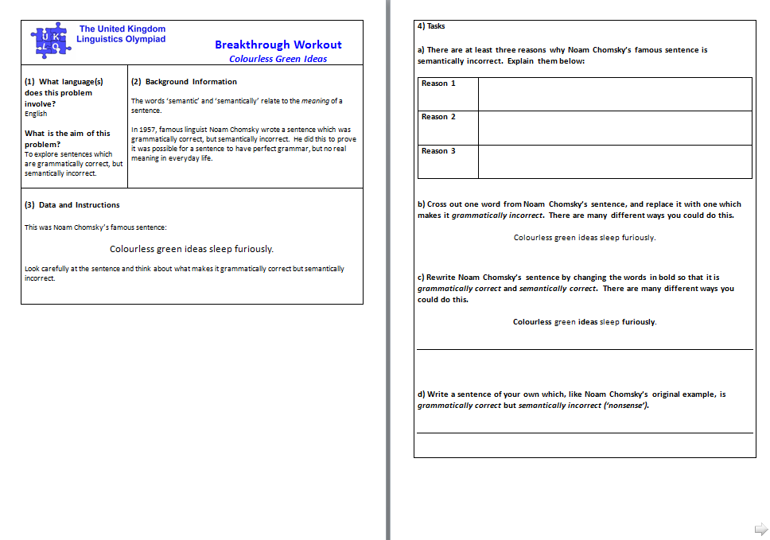

Slide 21
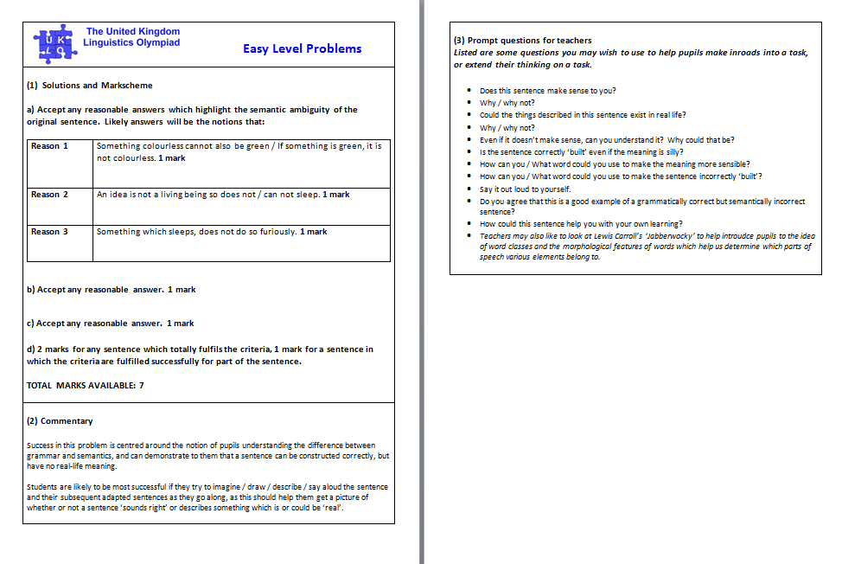

Slide 22
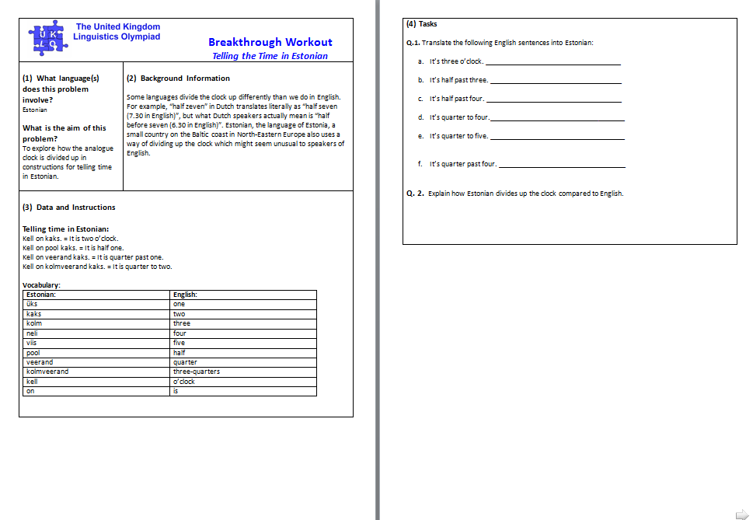

Slide 23
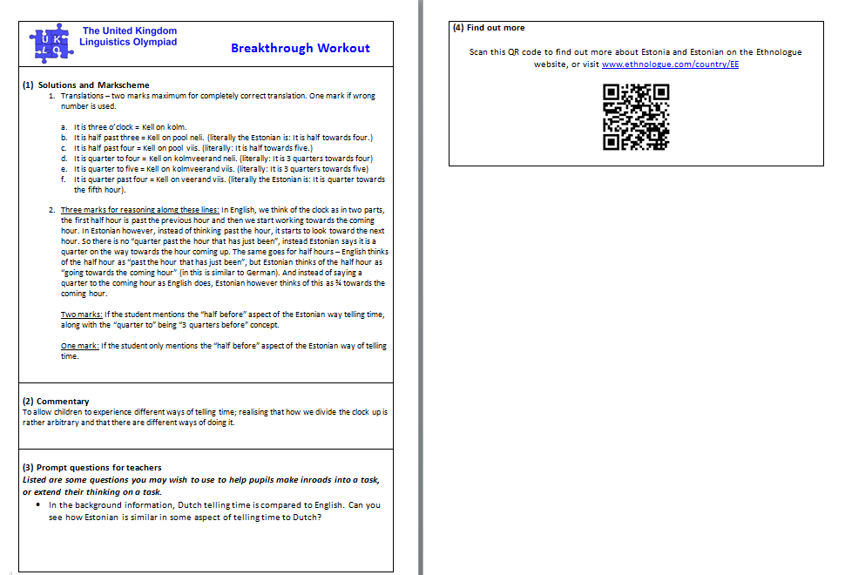

Slide 24
Broader cross-curricular work
US middle school teacher David Pippin’s work has shown that linguistics can be a serious subject for scientific study, for example with this phonology problem:
“...attempt to explain New England /r/-less-ness and intrusive /r/ in words such as ‘water’ and ‘law’ when used in a variety of sentences”
This kind of work offers children a scientific way to think about language, allowing them to:
develop and hone methods of scientific inquiry
pose questions
collect and analyze data
formulate testable hypotheses
test, revise and reject hypotheses
Honda, M., O’Neil, W. and Pippin, D. “On promoting linguistics literacy” in Denham, K. and Lobeck, A. (ed.) “Linguistics at School” (2014: 175-177; 187-8)
Socio- and historical linguistics can offer different perspectives in citizenship, history, geography and politics lessons. The following sites provide a wealth of information:
www.endangeredlanguages.com
www.languageonthemove.com
www.languageinconflict.org
www.ethnologue.com

Slide 25
In summary…..
Use linguistics terminology for in-depth investigation of texts
‘Little and often’ for every day use
Make use of linguistics for spontaneous speech opportunities
Consider the benefits of linguistics for
Enrichment
Intervention
Transition
Value sociolinguistics as a ‘way in’ to humanities and cultural work
Stay in touch!

Slide 26
Resources and support
Sarah Campbell
UKLO
akasarahcampbell@gmail.com
akasarahcampbell.weebly.co.uk
Twitter @akasarahc
www.uklo.org/about/contact
www.facebook.com/UKLinguisticsOlympiad
@UKLingOlympiad

Slide 27
Resources and support
United Kingdom Linguistics Olympiad (UKLO) and UKLO Breakthrough Workout | http://www.uklo.org http://www.uklo.org/breakthrough-workout
Global Communications Key Stage 3 Linguistics Course | http://globalcommseducation.weebly.com/
Kristin Denham’s Linguistics in K-12 Education links page | http://www.kristindenham.net/#!ling-in-ed/c1sju
Western Washington University (Kristin Denham) Linguistics in Education resources | http://www.teachling.wwu.edu/
Kristin Denham’s Exploring Languages resources page | http://www.explorelanguage.org/
Association of School and College Leaders / Peter Downes Discovering Language Multi Language Awareness Programme | http://sha.org.uk/Home/About_us/Projects/Discovering_language/Discovering_language/
University of Glasgow Language into Languages Teaching (LILT) project and resources | http://www.arts.gla.ac.uk/STELLA/LILT/frameset.htm
Lingo Magazine | http://www.lingozine.com/ / http://www.lingozine.com/read-a-free-issue.html
Linguistics Glossary | http://www.englishbiz.co.uk/grammar/main_files/definitionsa-m.htm#Head
Ian Cushing (UKLO) presentation on using linguistics puzzles in English teaching | http://www.academia.edu/13343011/Cushing_I._2015_._Linguistics_puzzles_and_English_teaching._NATE_Newcastle
Notes:
0 mins - close

