Slide 1
Suzi Bewell, PGCE MFL Course Leader,
The University of York
Saturday 27th September 2014
Literacy, Languages and ICT: exploring creative ways of encouraging children to read and write in the target language with the use of free on-line media http://community.tes.co.uk/tes_modern_foreign_languages/b/tes_languages_week_2-6_june_2014/archive/2014/05/29/tes-languages-week.aspx

Slide 2
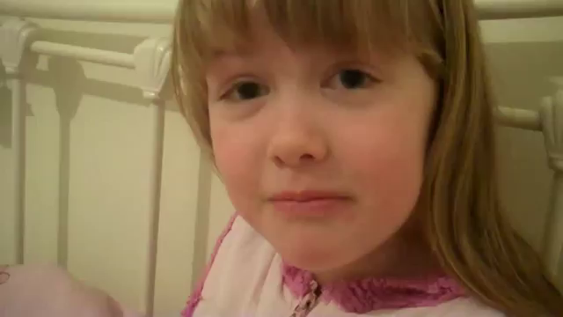
‘Je m’habille et je te croque’
https://www.youtube.com/watch?v=Rg7mTm2UHWU

Slide 3
SESSION AIMS
In this session, I will:
focus on how you can integrate TL stories, songs, poems, letters and short drama sketches into existing schemes of work
send you away with a better understanding of how to inspire your language learners to develop their literacy skills, in part, with the help of free on-line media
share with you links to lots of ready made resources so you can immediately implement some of the ideas on your return to school

Slide 4
The New NC and PoS for
KS3 Languages
The new Programme of Study for Languages at KS3 states that pupils should 'read literary texts in the language [...], to stimulate ideas, develop creative expression and expand understanding of the language and culture.'
Exemplification: TL stories, songs, poems, letters and short drama sketches

Slide 5
Literacy and Languages:
Receptive skills vs Productive skills
Teacher / pupil (individually / small groups) reads an authentic TL story / magazine to introduce a new topic / context (R)
Pupil produces his / her own mini book as an end of unit assessment (P)
Teacher sets up a penpal / etwinning link to encourage reading skills (R)
Pupil responds to penpal / etwinning partner by return letter / email (P)

Slide 6
Literacy and Languages:
Receptive skills vs Productive skills
Teacher uses rhythm and rhyme (songs and poems) to encourage correct pronunciation and intonation and to introduce new vocabulary (R)
Pupils create own verse to a song / well known tune (P)
Teacher invites a TL Drama company in to school to put on a performance for learners (R)
Pupils work with a local drama company to put on their own TL performance (P)

Slide 7
Guardian, 11 September 2013 http://tinyurl.com/language-teaching-crisis
‘Britain's foreign languages skills are in crisis. During the past month alone, ministers, university representatives, exam chiefs and industry bodies have each voiced their concern as entries to degree and A-level modern foreign language courses plummeted. So few young people are learning languages that in 10 years' time as many as 40% of university language departments are likely to close. Where did it all go wrong for UK language teaching?’

Slide 8
Taken from the same article:
Professor Mike Kelly
‘Young people are bored with describing their pets and what they do at the weekend […]
You've got to bear in mind that for 13-year-old kids, when they're making their subject choices, their decision depends heavily on what they enjoy studying.’
Conscious that the language curriculum is failing to inspire young people, schools and the Department for Education are looking at ways to make lessons more stimulating.

Slide 9
1. (Digital) Storytelling
TL readers
TL magazines
Web 2.0 tools
iPad apps
Talking dice / Story Cubes
Mini Books

Slide 10
TL readers
See PML Schemes of Work e.g. Catherine Cheater
Great range available from
http://www.little-linguist.co.uk/
http://www.europeanbookshop.com/
http://www.amazon.co.uk
http://uk.mantralingua.com/ (talking books)
http://www.growstorygrow.com/
(annual subscription)

Slide 11
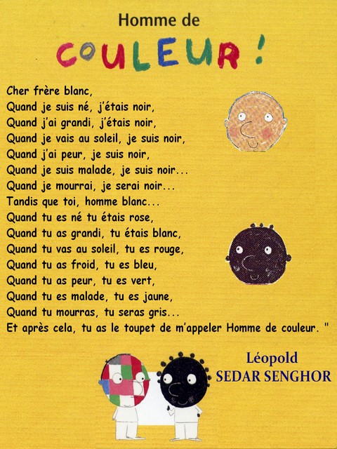
Topics:
Tolerance
Respect
Otherness
Language / Grammar:
Colours
J’ai… expressions
Future tense
Verb être

Slide 12
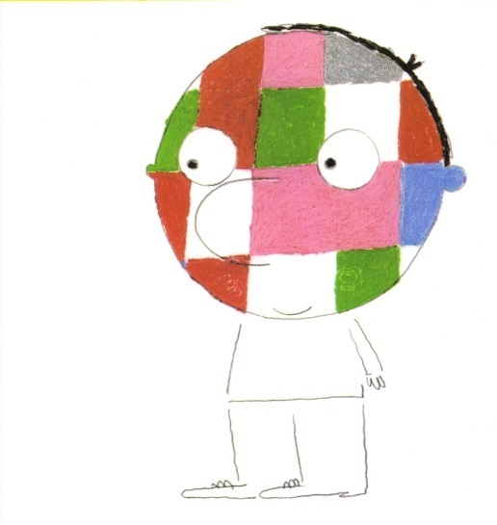
¡Hombre de Color!
un libro de Jérôme Ruillier

Slide 13
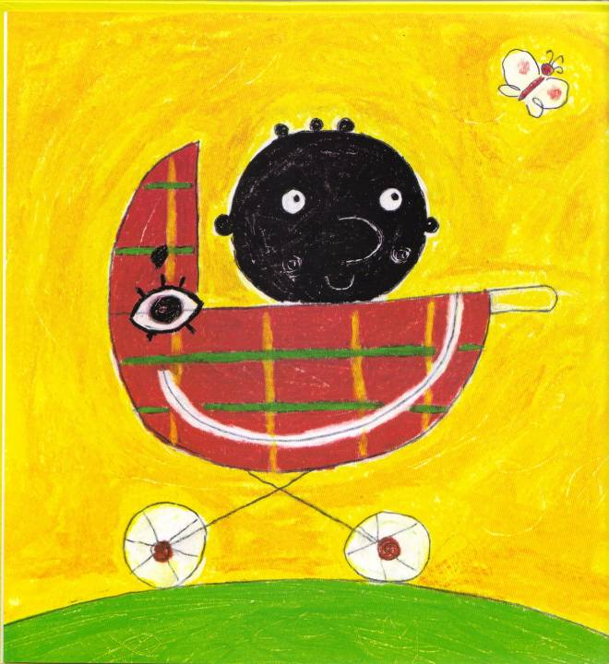
Yo, hombre negro, cuando nací, era..
...negro.

Slide 14
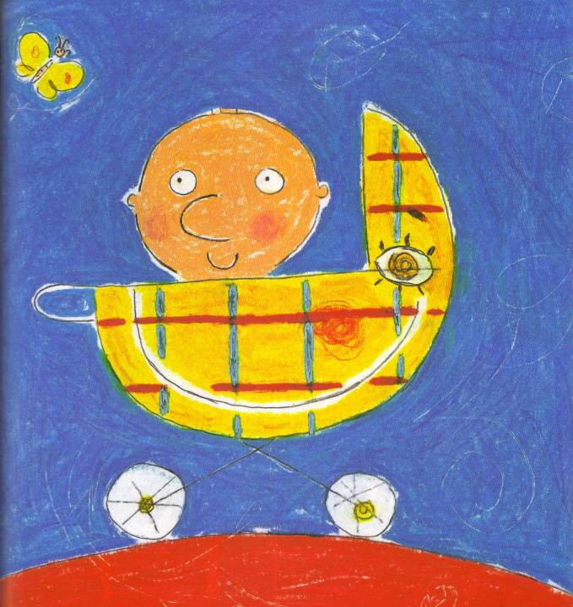
Tú, hombre blanco, cuando naciste, eras...
...rosa.

Slide 15

Yo, cuando crecí, era..
...negro.

Slide 16
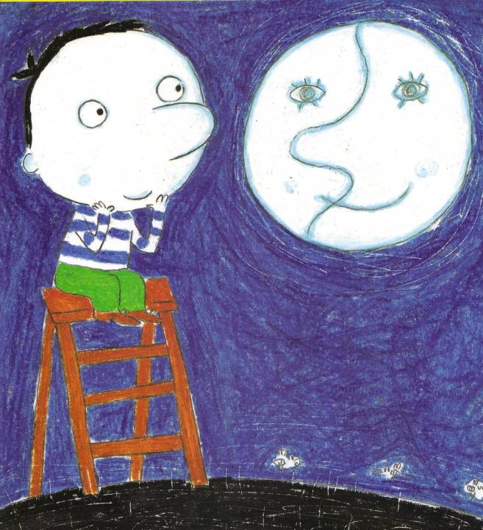
Tú, cuando creciste, eras...
...blanco.

Slide 17
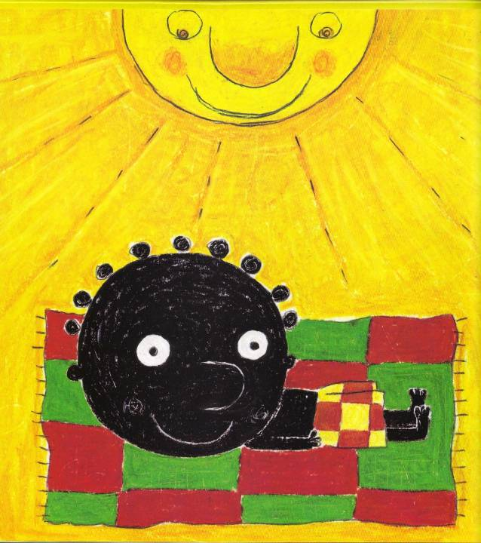
Yo, cuando tomo el sol, soy..
...negro.

Slide 18
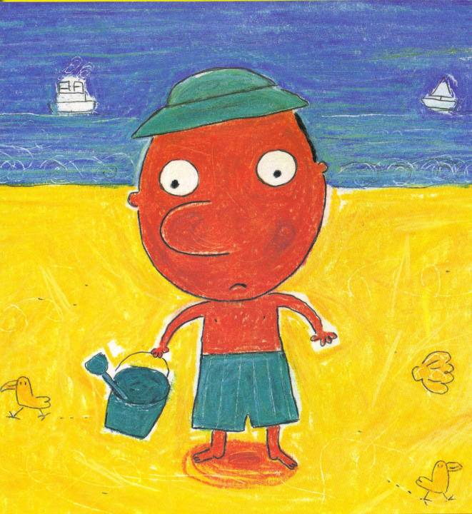
Tú, cuando tomas el sol, eres
...rojo.

Slide 19
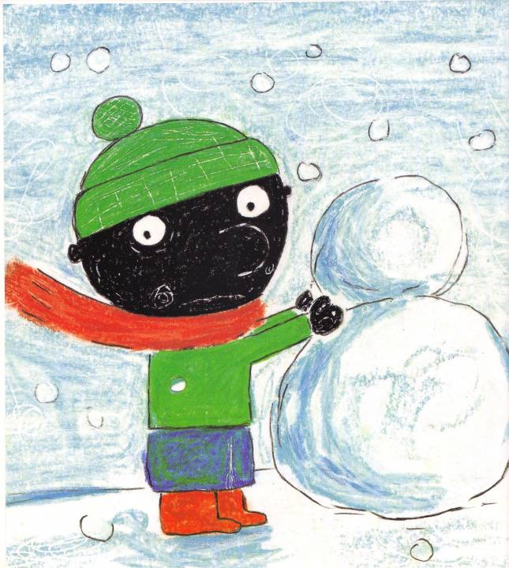
Yo, cuando tengo frío, soy..
...negro.

Slide 20
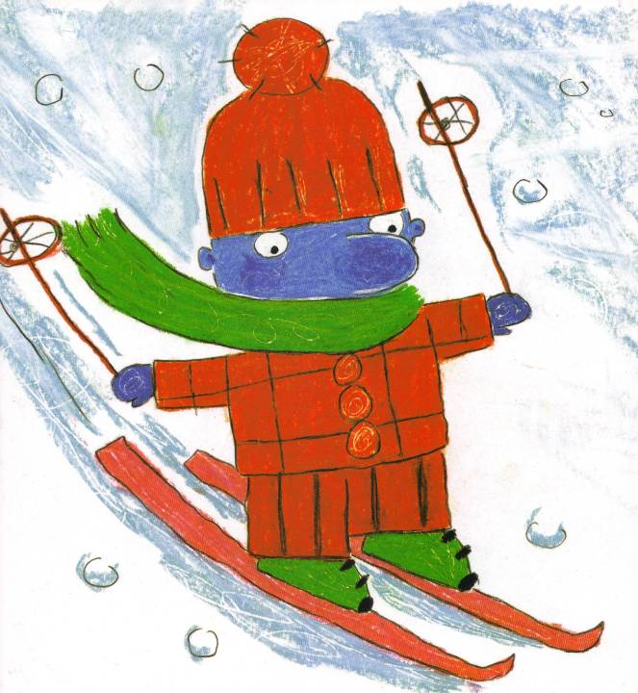
Tú, cuando tienes frío, eres..
...azul.

Slide 21
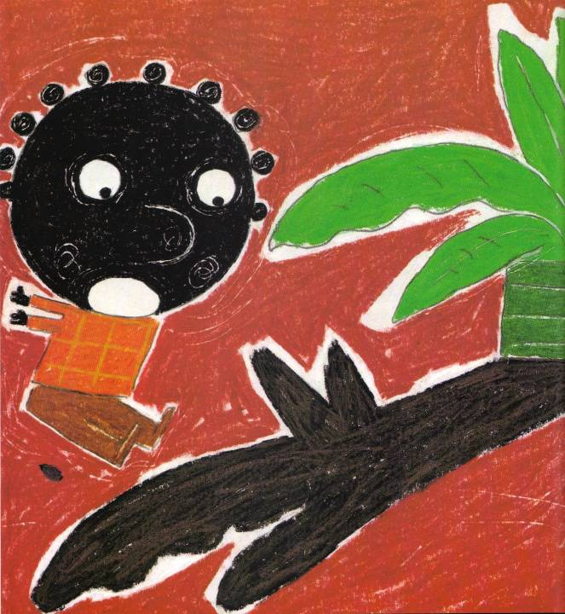
Yo, cuando tengo miedo, soy..
...negro.

Slide 22
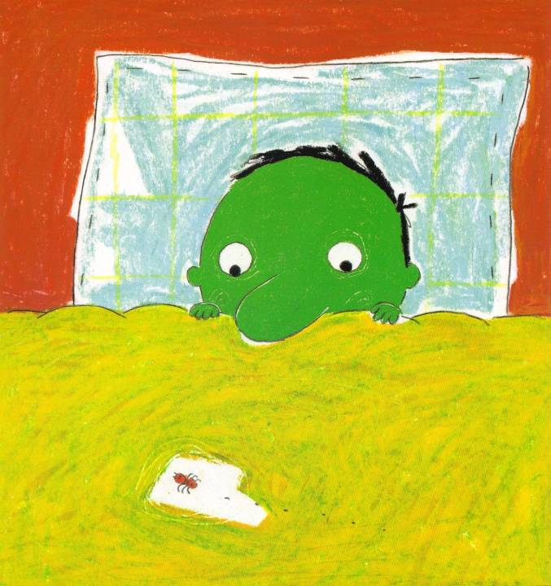
Tú, cuando tienes miedo, eres..
...verde.

Slide 23
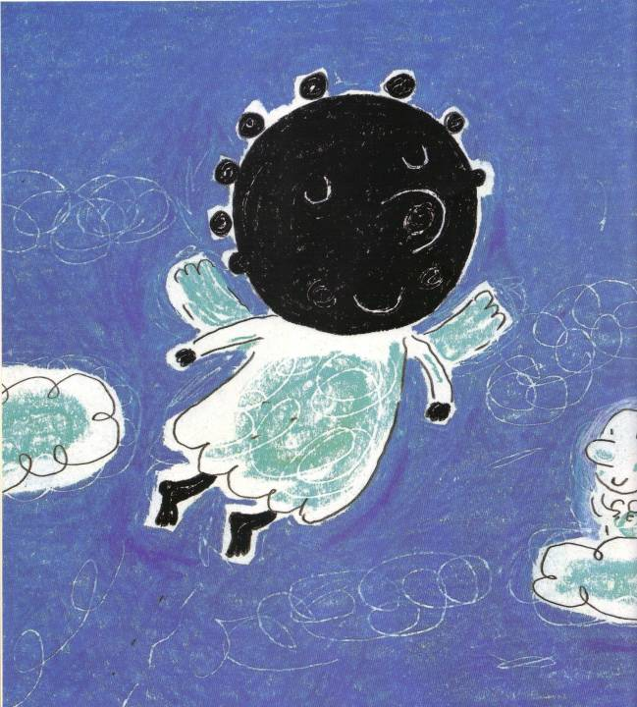
Yo, cuando muera, seré..
...negro.

Slide 24
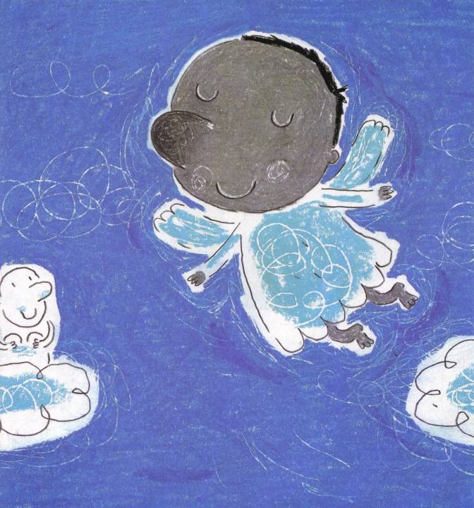
Tú, cuando mueras, serás..
...gris.

Slide 25
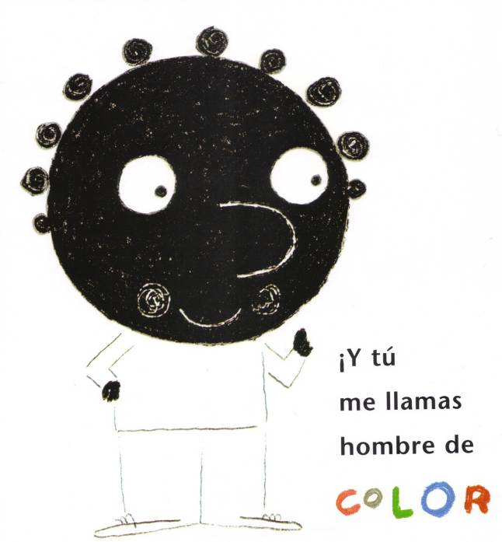


Slide 26
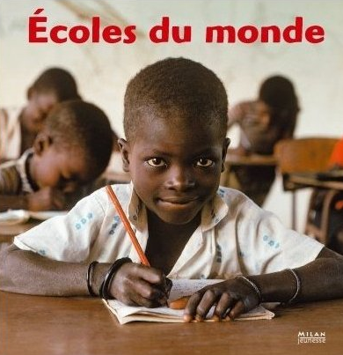
Using non-fiction texts:
Le droit à l'éducation
Ecoles du Monde - Milan Presse

Slide 27
Ofsted Achievement and Challenge
January 2011
According to the most recent MFL report by Ofsted:
“most secondary students’ (…) intercultural understanding (…) was weak in the majority of the schools visited because they did not have good opportunities to develop it”
“teachers made insufficient use of the wealth of authentic material that is available to develop students’ intercultural knowledge.”
www.tinyurl.com/ofstedlanguages2011

Slide 28
TL magazines
http://maryglasgowplus.com/ (access to online support materials and archive)
http://www.elimagazines.com/
http://www.frenchmagforkids.com/ (French)
http://www.playbacpresse.fr/boutique.172.nos-magazines.php (French)

Slide 29
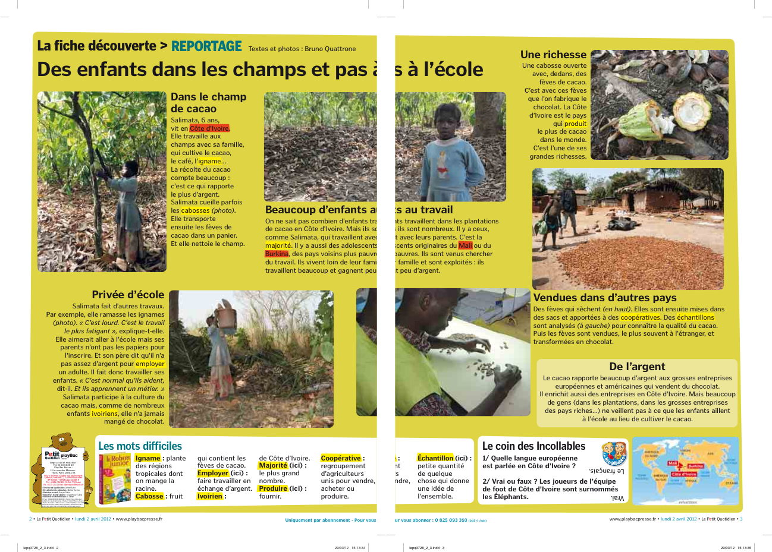

Slide 30
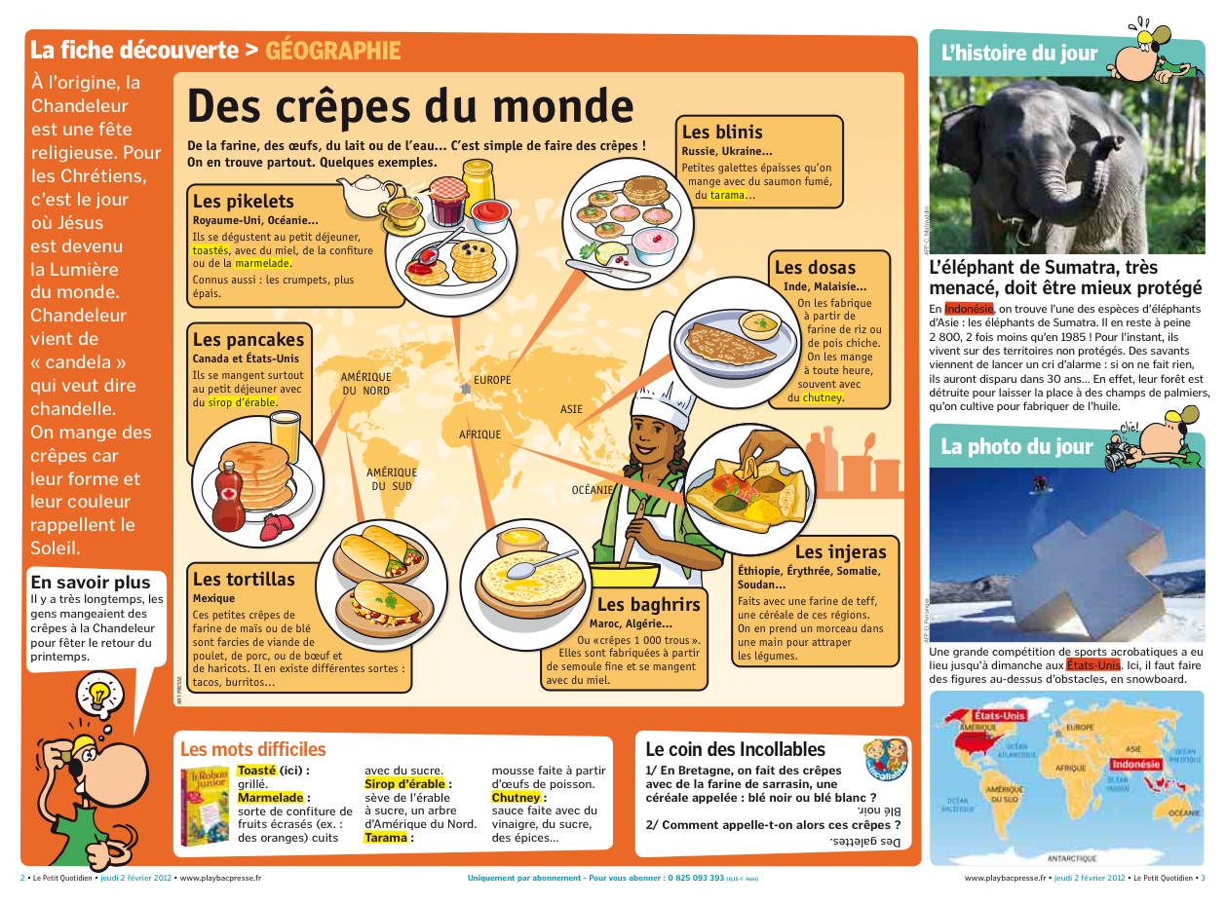

Slide 31
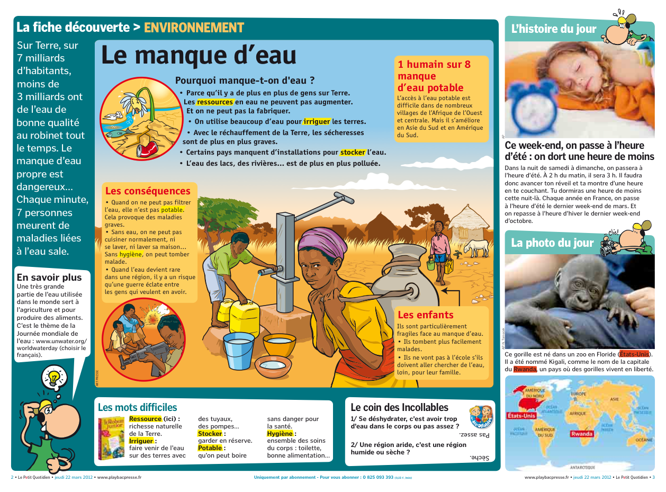

Slide 32
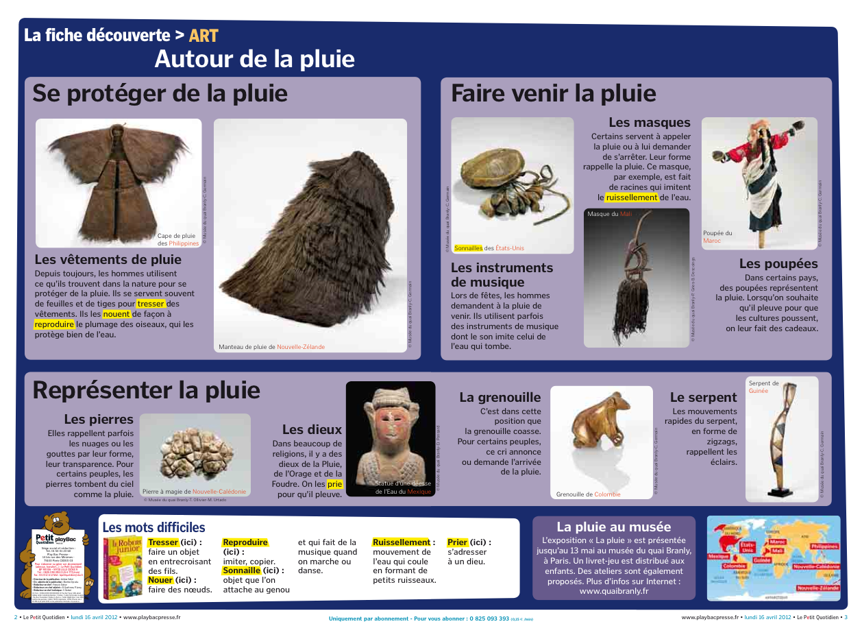

Slide 33
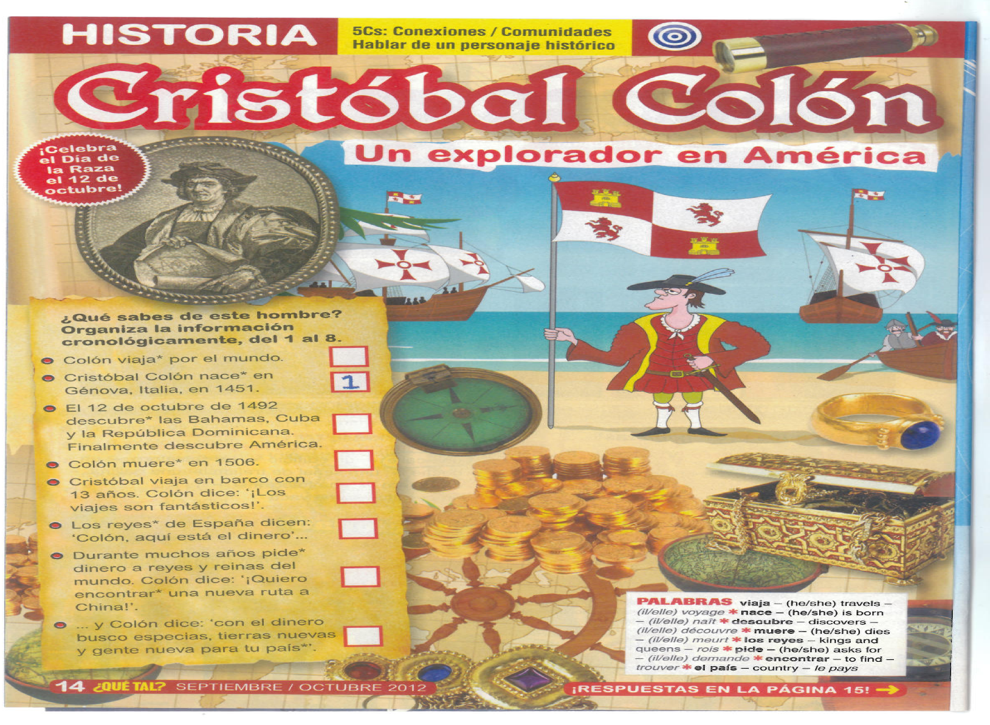
Target
Language
Magazines
= inspiration for cross curricular projects
Do you ever speak to your history colleagues in school???

Slide 34
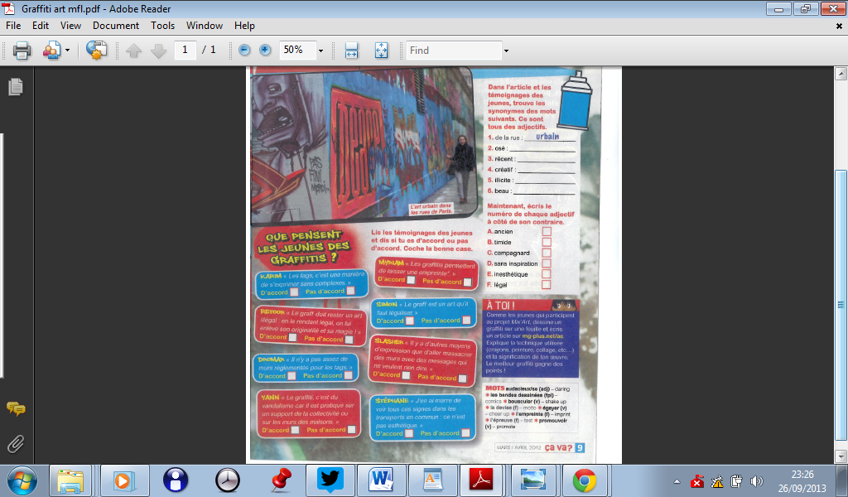
Meanings that Matter:
Interesting prompts for giving genuine opinions

Slide 35
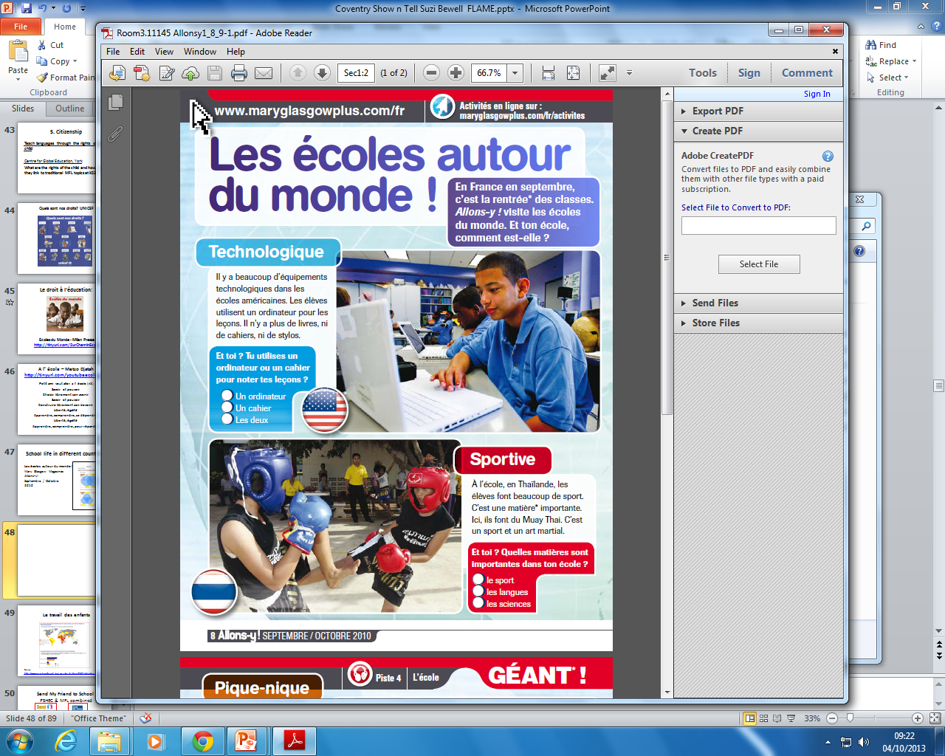
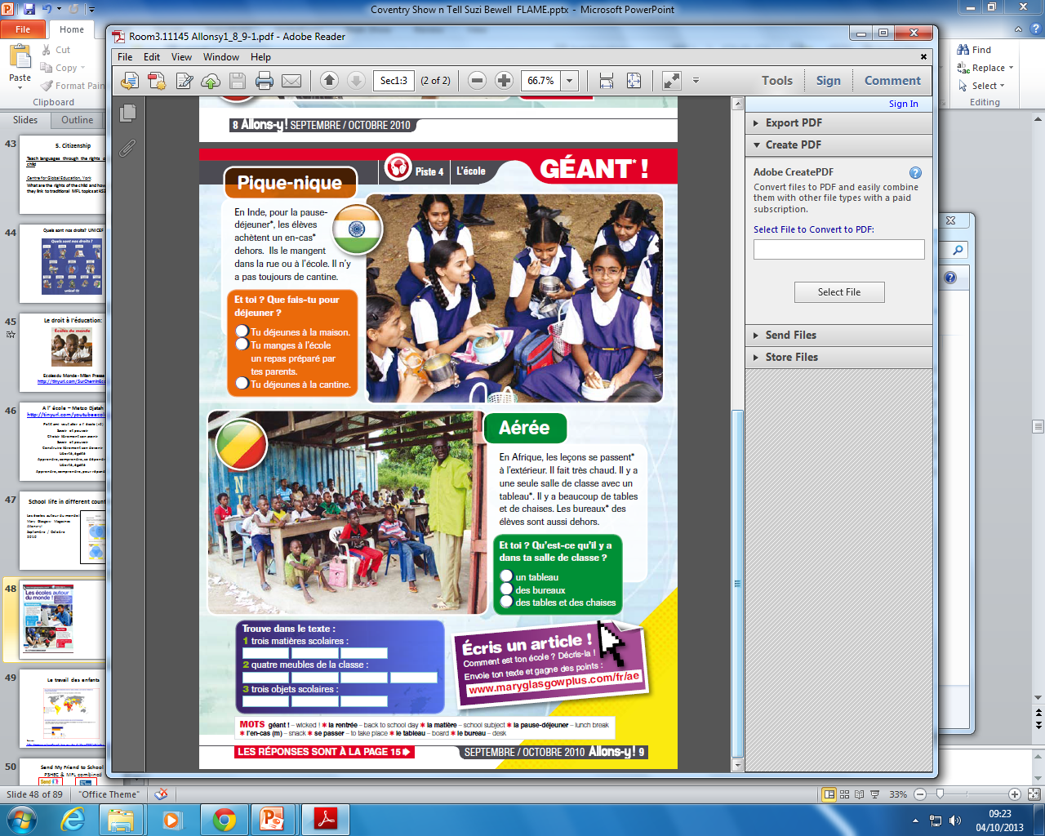

Slide 36
Web 2.0 tools for digital storytelling
www.storybird.com
http://storybird.com/books/les-vacances-by-katy-barker/?token=qhu9mkdk4h (Y9 Pupil)
http://storybird.com/books/les-choses-que-jaime-a-lecole/?token=u2cf7qrvz7 (Teacher produced story)
http://mfl-storybirds.wikispaces.com/ (collection of Storybirds ready to use)

Slide 37
Web 2.0 tools for digital storytelling
www.toondoo.com
http://tinyurl.com/ToondooPupilY8 (Y8 example)
www.goanimate.com
http://goanimate.com/videos/0NnfTGpxHT5c/1
(le week-end dernier, teacher produced example)
www.fodey.com (free newspaper generator)

Slide 38
iPad apps
Book Creator – The best App on the market
http://www.youtube.com/watch?v=M0J9ptwcGLw (video tutorial*)

Slide 39
Mini books – no ICT required!
Clare Seccombe, MFL Sunderland
http://changing-phase.blogspot.co.uk/p/mini-books.html
http://changing-phase.blogspot.co.uk/2012/07/mini-books.html

Slide 40
Talking Dice and Story Cubes
http://mobile.linguascope.com/info/dice.htm
http://www.storycubes.com/apps
Apps for iPad and actual dice

Slide 41

2. Music – Name that tune!
Aim: Using popular tunes to liven up traditional topics!
Wie ist das Wetter?
Desayuna.

Slide 42

http://www.youtube.com/watch?v=WEdt4col0Gc

Slide 43


Canción | Opinión | Razón
1) Un millon de cicatrices
2) Limon y sal
3) Nadie me perdonó
4) Hoy no me puedo levantar
5) Te recuerdo Amanda
6) Tenia tanto
moderna | sentimental/romántica
alegre | triste
divertida | aburrida
guay | chunga
tiene ritmo | no tiene ritmo
mola | tonta
fenomenal | mal
Me encanta…
Me gusta mucho…
Me gusta…
Me gusta bastante…
No me gusta…
Odio…
porque es…
Notes:
43

Slide 44
http://www.youtube.com/watch?v=wLXZ3bz4Kng
http://www.youtube.com/watch?v=8IzfnhVLuuE
Tenía tanto
Un millón de cicatrices
http://www.youtube.com/watch?v=tIpzfs5tBJU&ob=av2e
Limon y sal
http://www.youtube.com/watch?v=4xU12NYLj4k
La chica de ayer
http://www.youtube.com/watch?v=GhRAwDSRAFg
Hoy no me puedo levantar
http://www.youtube.com/watch?v=GRmre8ggkcY
Te recuerdo Amanda
http://www.youtube.com/watch?v=t5zWfADKgGk
No dudaría
Aldo (Los Aldeanos 2013) Nadie Me Perdono (Video Official 2013) - YouTube
Nadie me perdonó

Slide 45
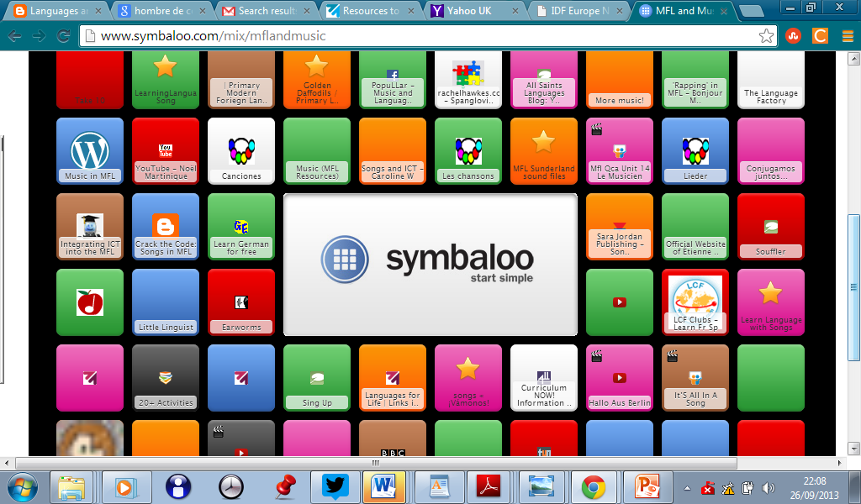
http://tinyurl.com/JAIcopain http://tinyurl.com/MusicMFLSBewell http://www.symbaloo.com/mix/mflandmusic

Slide 46
Music and MFL: a match made in heaven!
Today’s teenagers are overwhelming engaged with music: 92% of 14-17 year olds own an MP3 player and they listen to an average of nearly 2.5 hours of music per day.
Curriculum Now! Rachel Hawkes (ALL publication),
Unit 2: What’s in a song?
ALL Language Today magazine – Summer 2012 Issue
Visit: http://www.all-languages.org.uk/

Slide 47
3. Poetry
http://www.tes.co.uk/article.aspx?storycode=6291318

Slide 48
Der Schneemann
(phonic focus)
Ich bin ein kleiner Schneemann
Gemacht aus Schnee und Eis
Mein Hut ist schwarz,
Mein Schal ist rot,
Mein Mantel ist ganz weiß.

Slide 49
Der Schneemann
Ich bin _ _ _ kleiner Schneeman
Gemacht aus Schnee und _ _ _
_ _ _ _ Hut ist schwarz
Mein Schal ist rot,
Mein Mantel ist ganz _ _ _ _

Slide 50
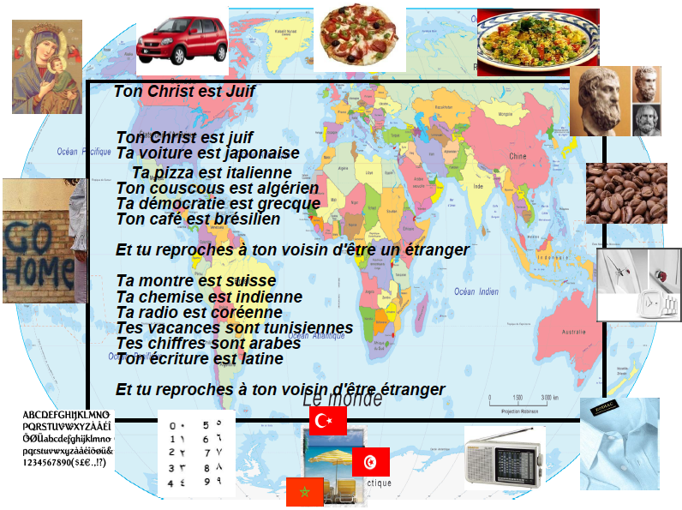
For this resource and many more see www.rachelhawkes.com
For examples of pupils’ follow up work see http://tinyurl.com/TonChrist

Slide 51
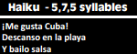
MFL Haiku
Spanish example:
(incorporating IU / wider Spanish Speaking world)

Slide 52
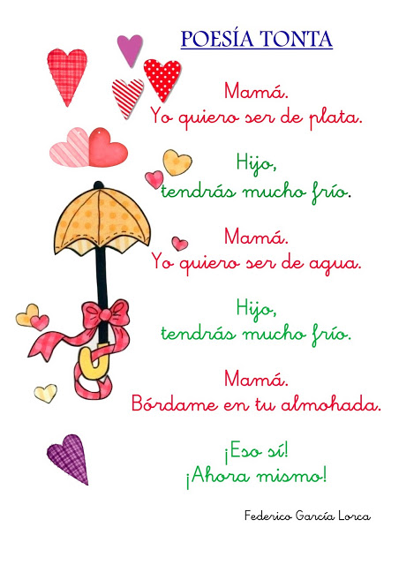
Google Search:
poesía para los niños
(images)

Slide 53
Basic ‘poetry’ - playing with similes
Rouge comme une tomate
Jaune comme… (+food)
Arm wie eine Kirchenmaus
... wie eine Katze (+adjective)
Estar más loco que una cabra
Estar más … que … (more open-ended)
Caligrams?

Slide 54
Poetry in MFL
Encourages genuine creativity
Revisit dictionary skills
Encourages independence
Run a competition to find the best poet
http://tinyurl.com/PoetryCompetitonMFL
Link where possible to TL country http://tinyurl.com/PoesieReunion
http://www.kidsweb.de/schule/poesie.htm

Slide 55
4. Letter Writing
A chance to step away from the computer!
Children LOVE to receive letters and parcels – rare thing in the 21st century
Opportunity to develop reading and writing skills for a real purpose and audience
Where to start?

Slide 56

www.britishcouncil.org/etwinning

Slide 57
Why eTwinning?
International partnership development made easy!
Language learning and communication (written / oral) for a real purpose / audience
Safe and secure way to connect online
Teacher CPD – learning from your European peers

Slide 58
Why eTwinning?
Fantastic opportunities to develop your ICT skills – free face to face and online training
Fully funded travel opportunities – teachers and pupils – next steps
Unbelievably motivating for students / teachers
http://www.youtube.com/etwinning

Slide 59
5. Drama
Autumn Term 2008, Drama as a Y7 transition project
http://tinyurl.com/SB3PetitsCochons
York Theatre Royal PET project bid
Theatre Royal staff for free
Drama specialist
4 consecutive weeks
Performance in the final week

Slide 60
Drama PGCE MFL AGT pilot
Able, Gifted and Talented Year 9s
Local PGCE partner school
20+ trainee languages teachers lead free ½ day school’s event with a focus on learners improving their speaking and reading skills
Promote languages prior to Year 9 options
Raise the profile of languages

Slide 61
Panto Finale
Trainees (and course leader) perform Blanca Nieves with focus on getting learners ‘in on the act’
Recorded and added to YouTube for future reference
Extremely positive feedback from staff and pupils

Slide 62
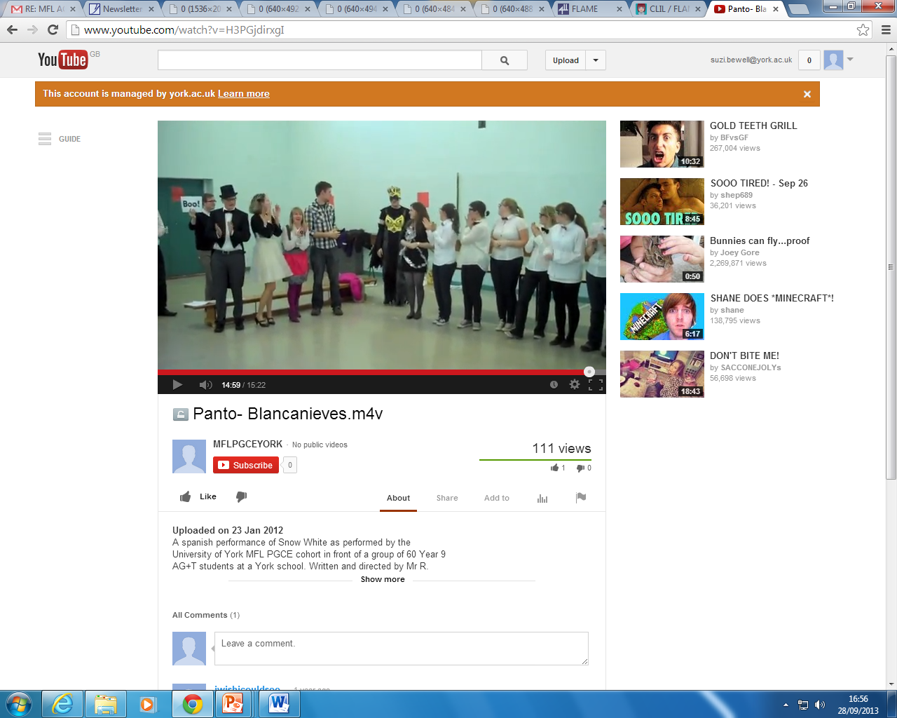

Slide 63
Charakter 1
doof
lacht viel
jünger als die
anderen Personen
Charakter 2
selbstbewusst
spricht sehr laut
Charakter 3
schüchtern
spricht sehr leise
Charakter 4
sehr energisch
bewegt sich viel
Charakter 6
sehr schlechter Laune
hört sich launisch an
stampft mit dem Fuß
Charakter 7
enthusiastisch
lächelt und klatscht in die Hände
Charakter 8
nachdenklich
kratzt sich am Kopf
starrt vor sich hin
Charakter 5
kommandiert gern
unterbricht ständig

Slide 64
The bigger the risk, the bigger the gain!
-Drama is a creative and cooperative form of learning.
-It really motivates students
-It can help to speed up the learning process
-It can mean bringing real life as well as fantasy situations and characters into the classroom.
-It requires enthusiasm and a willingness to take risks on the part of the students and the teacher.

Slide 65
Useful Drama and MFL links:
http://www.linksintolanguages.ac.uk/resources/2561 * Linked Up
http://www.kidsinco.com/about/ * Spanish examples
http://tinyurl.com/FRXmasPlay * ( www.audioboo.com )
http://www.play-script-and-song.com/fsl-french-activities.html * French examples
http://tinyurl.com/TESAschenputtel * German e.g from TES resources

Slide 66
IDEAS GALORE…
But what are your next steps?
*Select one or more themes from today’s talk
*Brainstorm ideas with colleagues back in school
Plan a lesson / series of lessons
Resource the lesson(s) together – share the
workload
Be prepared to test and evaluate the impact this
has on your learners and modify accordingly

Slide 67
Fight the good fight!
suzi.bewell@york.ac.uk
www.petitepipelette.wordpress.com

