Slide 1
Severe Grading in MFL
Nick Mair
Director of Languages, Dulwich College
Past Chair of Independent Schools Modern Languages Association [ISMLA] and ongoing responsibility for grading issues
Vice Chair ALL-London
Involved with setting up of City Heights E-Act Academy (languages specialism)
One year spent teaching ML at Isle of Sheppey Academy

Slide 2
A long journey nearing its end??.....
Delighted to be here today, and delighted that Ofqual have launched this discussion and holding this seminar
ISMLA, ALL and ASCL have worked closely together on severe grading in MFL for 10 years now – state & indept; teachers & Heads
With support from HMC, GDST, NAHT etc
ALL = Assoc. for Language Learning
ISMLA = Independent Schools ML Assoc.
ASCL = Assoc. of School and College Leaders

Slide 3
Severe Grading in MFL - some of the people past and present
Helen Myers (Past President, ALL & Asst Head, The Ashcombe School) website: www.all-london.org.uk
David Blow (Head, The Ashcombe School; ASCL Data Group)
ISMLA: Duncan Byrne (former Chair), Geoffrey Plow (Exams), Alex Frazer (Exams)
ASCL: John Dunford (former Gen. Secretary)
HMC: William Richardson (Gen. Secretary)
Peter Downes (former Chief ML examiner, former Head, former President ALL & SHA now ASCL)

Slide 4
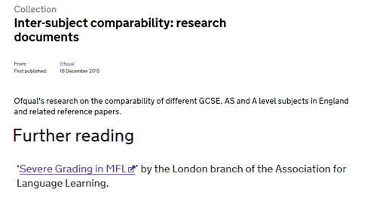
Citations in Ofqual docs
Inter-subject comparability: research documents
www.all-london.org.uk/severe_grading.htm
"Inter-Subject Comparability: A Review of the Technical Literature- ISC Working Paper 2“
Page 10: "In more recent years, the debate on inter-subject comparability has been driven largely by subject groups. Those with an interest in languages (Myers, 2006; Dearing and King, 2007) and mathematics and sciences (Coe et al., 2008; Royal Society, 2008) have been particularly vocal.“
Page 45: Myers, H. (2006) The ‘severe grading’ of MFL grades at GCSE and A level. London, Association for Language Learning.

Slide 5
Severe Grading in MFL - brief history
Long-standing concern - research by Nuttall in 1974; Peter Downes raised over time, leading to recommendation in the Nuffield Report
Series of presentations from 2005 onwards by Helen Myers and David Blow using official data (DfES/DCSF/DfE, Ofsted, QCA/Ofqual etc)
Continuing concern in ML community, esp from 2004 when Languages no longer compulsory at KS4 and GCSE numbers go into freefall
Series of meetings by ISMLA, ALL, ASCL etc with ministers, QCA, exam boards

Slide 6
Severe Grading in MFL - brief history (2)
Initially, 2005 – 2008 during Dearing Review etc, phrase was “perception”
2008 Ofqual seminar on Inter-subject Comparability (see ISC Paper on official views at the time) – Helen Myers and David Blow presented on behalf of ML community (together with STEM and English reps) – see later slides
So focus then was on convincing about the reality; that has now been accepted and evidenced in the Ofqual ISC papers

Slide 7
Official Reports
JCQ Report into M.L. (July ‘14) – GCSE and A/L
Paper 1: The decline in uptake of A-level Modern Foreign Languages: literature review (Dr Debra Malpass)
Paper 2: Attitudes towards Modern Foreign Languages (Ipsos MORI)
Paper 3: A-level Modern Foreign Languages: why so few A*s? (Ben Jones, Beth Black & Christine Wong)
Paper 4: A-level Modern Foreign Languages: assessment instruments and script analysis (Beth Black)
Ofqual Report (Sep’14) – A/L esp A*
JCQ report and Ofqual report into ML looked in detail at all the factors from content through to assessment (questions) to marking to grading that contribute to variability (some typical, others undesirable)
http://www.jcq.org.uk/media-centre/news-releases/mfl-review-press-notice
Ofqual Report: http://ofqual.gov.uk/news/improvements-made-level-foreign-languages/

Slide 8
Importance of language
Terminology is important. Words like “hard”, “standards”, “demand” carry multiple connotations.
"An earlier version of this article used the expression 'marking down'. Ofqual would like us to clarify that the issue not about the quality of the marking but rather about how likely a student is to get a good grade depending on the exam subject. We have amended the article to avoid confusion.“
note at end of Daily Mail article on ISC (Jan ‘16)
thanks to Peter Tymms and Robert Coe for the phrase “severe grading” from Sept ’04 - The Times: “Student offers “should recognise easy A-levels”
Notes:
the terminology is important
One could try and make a case based on other factors for outcome GCSE grades e.g. how much study have pupils done in a particular subject? what is the quality of the teaching and learning?
BUT no such systematic study has been done - the reality is that the issue of comparability of grading dates back to the old O level maths and O level English - readers of the Cockcroft report in 1982 (when I started out!)will remember the stark statistic that 33% gained an O level English, 25% gained an O level maths. The relative gap between those subjects has been pretty consistently maintained over the last 20 years - perhaps as a consequence of the relentless media focus on 'standards' versus 'dumbing down'.
Business Studies, where they start form scratch in Y10 - are the grades for that lower than others? Of-course not.

Slide 9
Distractors
Need to avoid invalid comparisons / deductions re. severe grading, numbers etc STEM v ML etc Our line on numbers has been: “Making changes here [grading] will not in itself solve the overall problem [pupil nos], but, to use a metaphor, will remove having a hand tied behind one's back.” ASCL / ISMLA / ALL to Dearing
Need to look at each subject, Govt incentives, etc

Slide 10
Sensitivity
We do not underestimate the sensitivity of this topic
Through all of our involvement, have sought to make politically (and media) realistic proposals - e.g Lord Dearing in 2006 liking the idea of comparability with Maths: “no-one will say that Maths is easy”
So he would have been pleased with headline in Jan 2016 Daily Mail article on ISC !

Slide 11
Media
Daily Mail Jan 2016 article about the Ofqual ISC papers "At GCSE the hardest subjects – modern foreign languages, Latin and statistics, are about half a grade harder than the average."
http://www.dailymail.co.uk/news/article-3398347/Official-Exams-soft-subjects-really-easier-Board-admits-pupils-unfairly-marked-courses-maths-discuss-overhaul-grading-system.html

Slide 12
Dearing Review – press - 2007
Dr Coe, of Durham's curriculum, evaluation and management centre, believed such trends were repeated in other years, but insisted "the question of difficulty is not about content of the subject ... It is purely about the examination and grading process."
David Willetts, Conservative education spokesman, said: "If there is evidence modern languages is tougher than other GCSEs, then that is something that has to be corrected. They should be the same level of challenge as traditional academic GCSEs." http://education.guardian.co.uk/gcses/story/0,,2031769,00.html
James Meikle, education correspondent Monday March 12, 2007

Slide 13
A* in A/L ML
Subtle distinction
NOT looking at the judgemental boundary A/B
BUT looking at the proportion of A* relative to A + A*
We are comfortable that the overall % of A+A* will vary from one subject to another because cohort profiles vary, but argue that the RELATIVE proportion of A* should be comparable esp amongst “facilitating subjects”

Slide 14
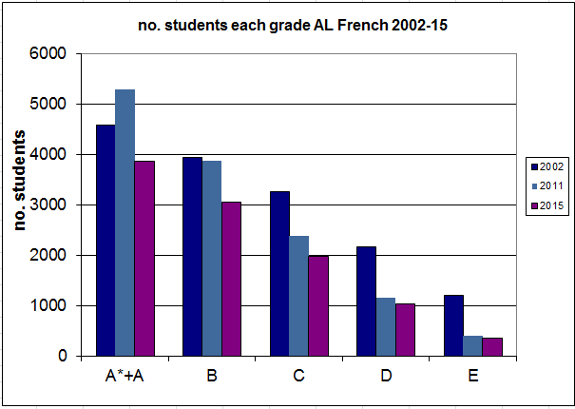
Severe grading at A/L
Sadly this has become almost “horse has bolted” as much of the damage has been done. In 2004 clearly, severe grading was a major issue especially at AS level. Look at the stark drop in candidates in the last 10 years at E grade; no. of E grades in 2015 was 29% of the number in 2002

Slide 15
A/L nos
Which has led to a major mismatch at A/L between the “difficulty” of the exam and the cohort profile – Ofqual report
And since 2010 we have had the A* issue as a final nail in the coffin
A&A* stable until 2012, when a drop of 1,000 candidates to 2015

Slide 16
Other issues, NOT being considered today
“Unreliable grading” esp at A/L ML Oral
How “hard” / “easy” an exam paper feels to a candidate (as professionals, we know (or should know) that a “difficult” paper with low scores does not need to lead to low grades as the grade boundaries /conversion to UMS will be adjusted to compensate)

Slide 17
GCSE MFL grading
Our outline principle is that typical students studying a mainstream GCSE ML should have a reasonable expectation that they will get similar grades across EBacc subjects, without any systematic variation.
So, looking at the many different ways of analysing cohort performance, ML should be brought broadly into line with the other EBacc subjects e.g. Maths
Notes:
Our outline principle is that students studying a particular GCSE subject should have a reasonable expectation that they will get comparable grades across a range of subjects.
The PANDA Relative Performance Indicator measures the performance of students in their other subjects compared with the particular one. By the principle above, these should be negligible. They are not.
This brings together what we have jus been saying.
It's tempting to get sucked into other issues BUT

Slide 18
Dearing Review
National outcry at drop in numbers GCSE Aug 06 - Alan Johnson sets up Dearing Review
“Mr Johnson wants to see what more can be done to encourage14-16 year olds to study GCSE or other language courses leading to a recognised qualification.” DfES Press Notice 2006/0144 Oct 06
Meeting Nov 06 with Lord Dearing
Idea of broad comparability with Maths grading
Awareness of public and political sensitivity

Slide 19
Dearing Review
Led to recommendation in Consultation Report (Jan 07) confirmed in Final Report (Mar 07) to have definitive study published on “perception” of severe grading (with implicit corollary that there should be action...)
the consultation had “found strong confirmation of the view that award of grades is more demanding than for most other subjects”

Slide 20
Issues for pupils
Perceive that they are performing worse in languages in other subjects
Reduces the take-up at KS4 and A-level
In each case, pupils are doing relative comparisons on grades (note key issue at AS in French as compared with other subjects - at A2 Univs can make subject by subject adjustments)
Notes:
Let's put ourselves in the shoes of the pupils. You’re not a ver very high flyer, but you try hard and you’re targeted a mixture of As and Bs. You enjoy your lessons, but you've had the unpleasant experience of sitting a mock exam where you feel you didn't do very well (some higher papers need roughly half marks to score an A grade ... so that pupil had the experience of being clueless for half of the exam, even though they are an 'A' grade candidate
You hear from the school 'network' of students that their language grades are lower than their other grades at AS and A level.
You're not going to do MFL at uni .. you just want a couple of subjects to enjoy alongside your favourite.
When the results come through, you have a lower grade in French than in your other subjects.
Will you choose French?
(Chris Maynard made refernce to this in his talk, acknowledging that there were 'tactical decisions' made by pupils)

Slide 21
Issues for staff & managers
Heads and Governors may think that languages are “under-performing” so issues re Performance Management etc
External people e.g. Ofsted may think same or that the school as a whole is “under-performing” against current performance measures
Notes:
So, we all know these issues don't we?
HODs being taken to task because a simplistic interpretation of grades leads Heads and Governors to the conclusion that we're under-performing.
The meaning of 'target' ...
Every August we read in the papers as we're all accused of allowing standards to slip and allowing pupils to choose 'soft' options.

Slide 22
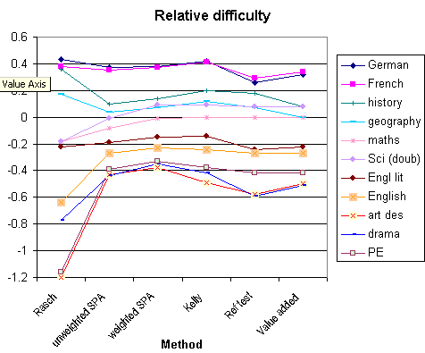
Way forward
Slide from Ofqual Oct ‘08 ISC seminar
We believe it is unrealistic to move to comparable grading for all subjects
Currently 4 main bands
ML
Maths, Sci, His, Geo
English
Art, Drama, PE,
We are proposing simply that ML moves into the 3rd band - tiny changes in grade boundaries involved, similar to those which have taken place - “one-off step change”
data from CEM SCORE paper

Slide 23
Joint ASCL, ALL, ISMLA statement re QCA report 2008 in response to Dearing
Dr John Dunford, General Secretary of ASCL said: “The main problem is that modern language GCSEs are graded more severely than other subjects and it is extremely disappointing that the QCA, while recognising the problem, does not intend to bring the grading of GCSE languages into line with mathematics, English and other similar subjects.”
“This is not an issue of ‘dumbing-down’ language GCSEs, it is levelling the playing field with other similar subjects .....not to maintain a grading standard that was unfair to begin with.
20 Feb 2008

Slide 24
Views on Ofqual proposals
Ofqual needs to have an approach
“No action should be taken” – this would perpetuate all the existing problems
“Action to achieve inter-subject comparability” – probably too far for ALL subjects; need bands/groupings
“Post hoc action to achieve inter-subject comparability” – too remote and does not address the reality in the classroom
“Action to achieve an alternative to inter-subject comparability” – same norm-referencing for all subjects does not take account of cohort ability.
✗
✓?
✗
✗
Need a pragmatic approach to tackling the anomalies. Vital to take action, and so need to be flexible
✓

